Slide 1
Primary motor cortex does not exhibit orderly dynamics during grasp
James M. Goodman
Aneesha K. Suresh
Elizaveta V. Okorokova
Matthew T. Kaufman
Nicholas G. Hatsopoulos
Sliman J. Bensmaia
Notes:
Hello all, and thank you.

Slide 2
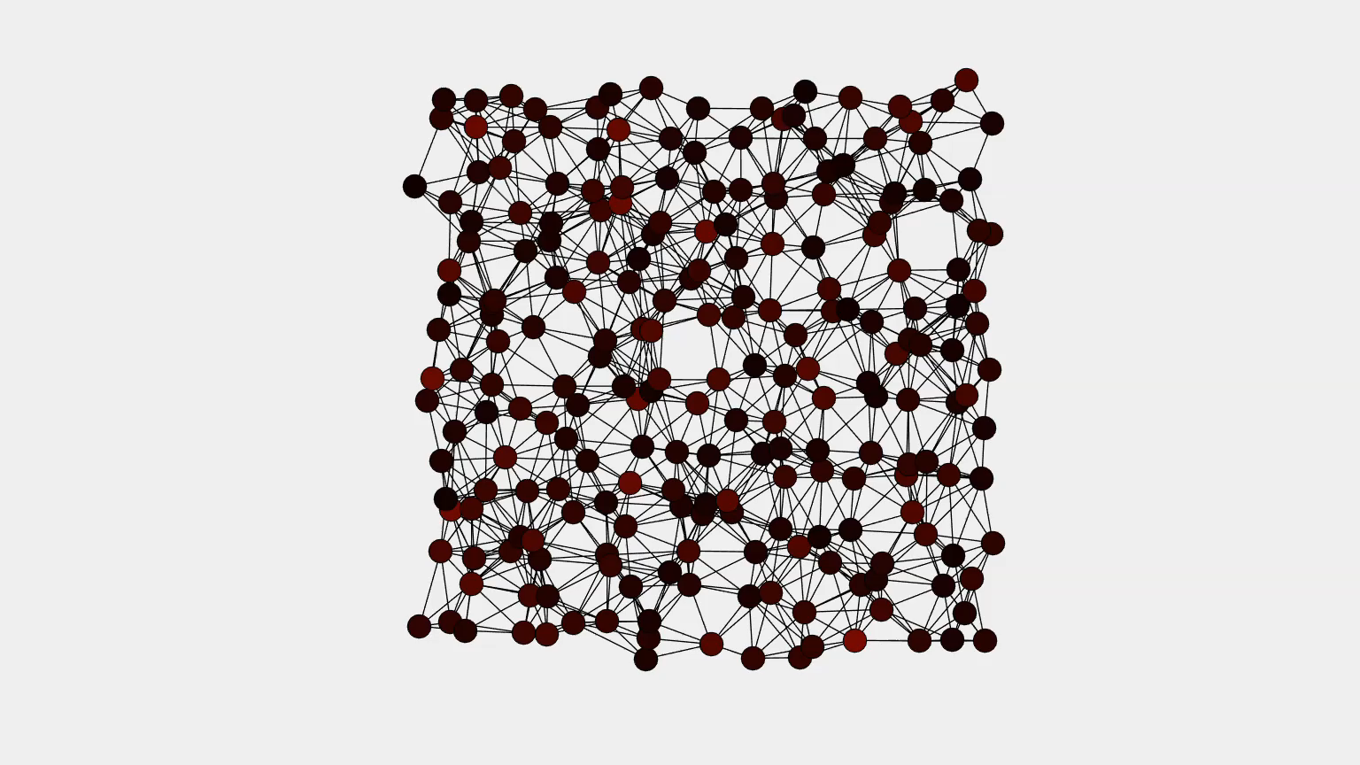
Neural populations and output generation
Notes:
I’m going to be talking today about our forays into addressing a fundamental question of motor neuroscience, one that asks: how are spatiotemporal patterns of activity in M1 coordinated to give rise to movement?

Slide 3
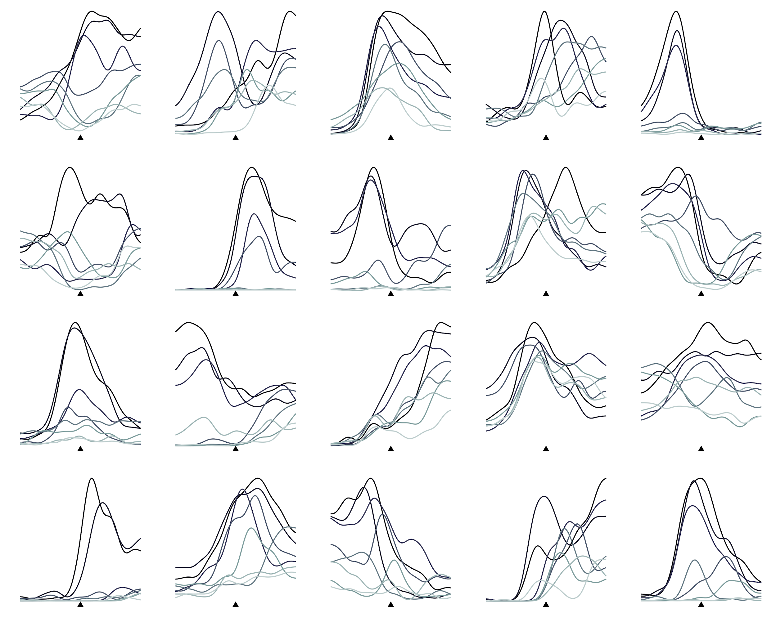
Single-neuron structure
Notes:
*Tighten this. Looking at patterns of activity on a neuron-by-neuron basis, it’s difficult to ascertain the population-level structure that gives rise to and coordinates this activity.

Slide 4
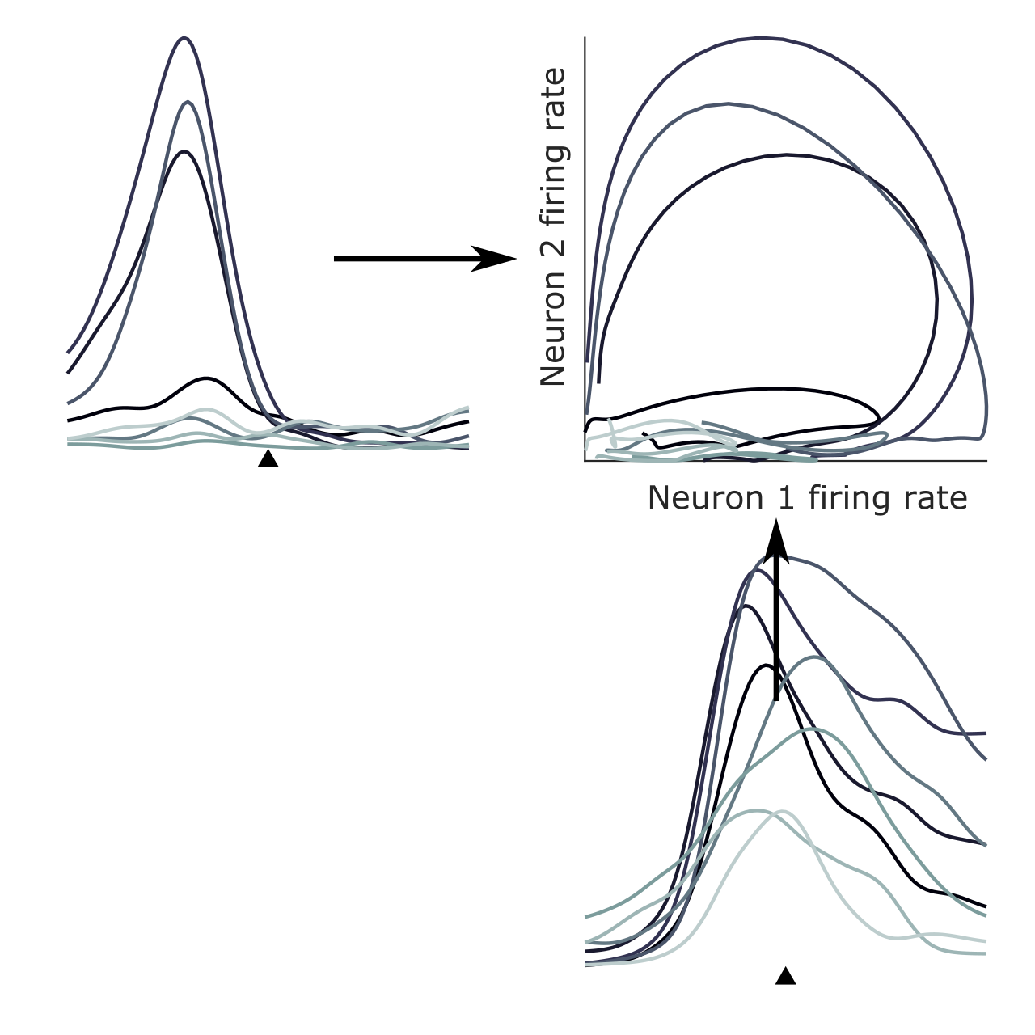
Neural “trajectories”
Notes:
*Tighten this. To address this question, we instead represent how population activity evolves over time as trajectories in space. In the case of a two-neuron population, this involves showing the firing rate of one neuron against the firing rate of the other. We can do a similar thing for larger populations of neurons and visualize them by projecting onto a lower-dimensional space.

Slide 5
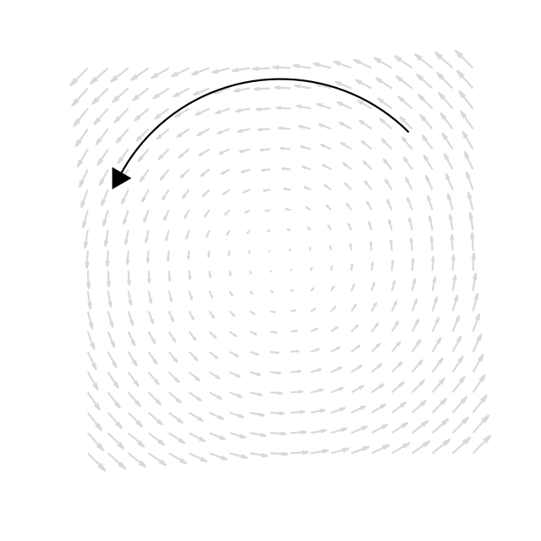
Dynamical systems
Notes:
The resulting representation of the time-varying population activity is then amenable to dynamical systems analyses.
To briefly cover dynamical systems:

Slide 6
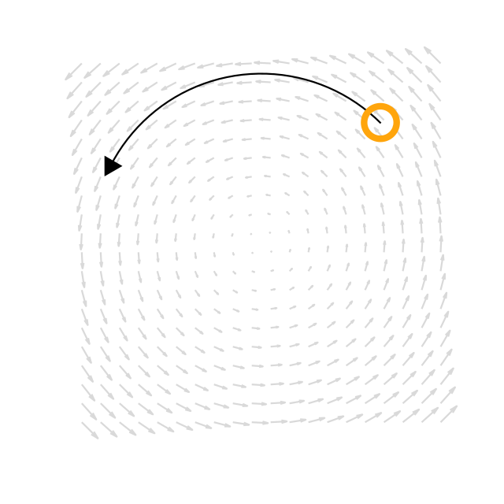
Dynamical systems
Notes:
In a dynamical system, broadly speaking, the state at the current time

Slide 7
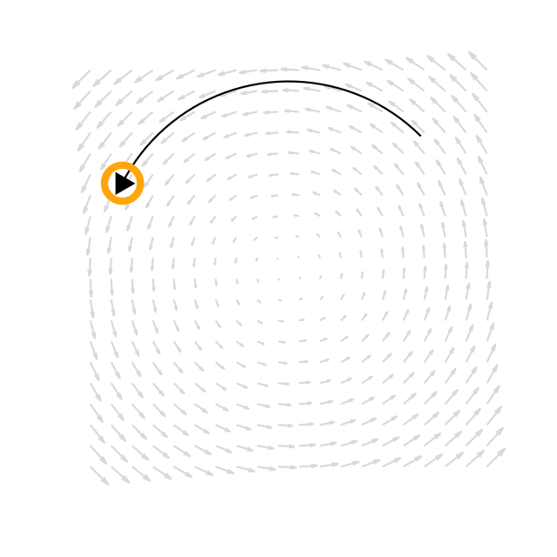
Dynamical systems
Notes:
predicts what the state will be in the future. For our purposes, a “state” refers to a pattern of firing rates spanning an entire neural population.

Slide 8
Varieties of dynamical system
Autonomous
Smooth
Linear
Rotational
Notes:
There are many flavors of dynamical system, each exhibiting different properties. The properties we are concerned with are:

Slide 9

Varieties of dynamical system
Autonomous
Smooth
Linear
Rotational
Notes:
Autonomy: In an autonomous dynamical system, the current state completely predicts the future state.

Slide 10

Varieties of dynamical system
Autonomous
Smooth
Linear
Rotational
Notes:
Smoothness: In a smooth dynamical system, similar states are associated with similar future states.

Slide 11
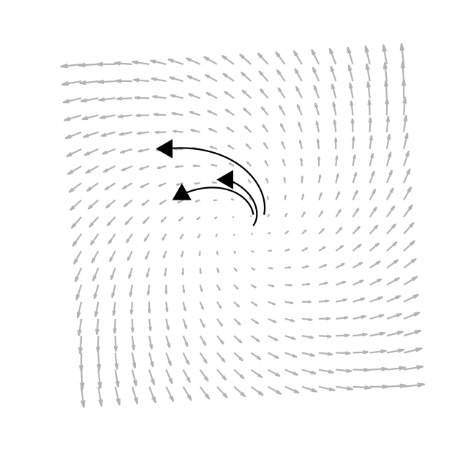
Varieties of dynamical system
Autonomous
Smooth
Linear
Rotational
Notes:
Linearity: In a linear dynamical system, states can expand

Slide 12
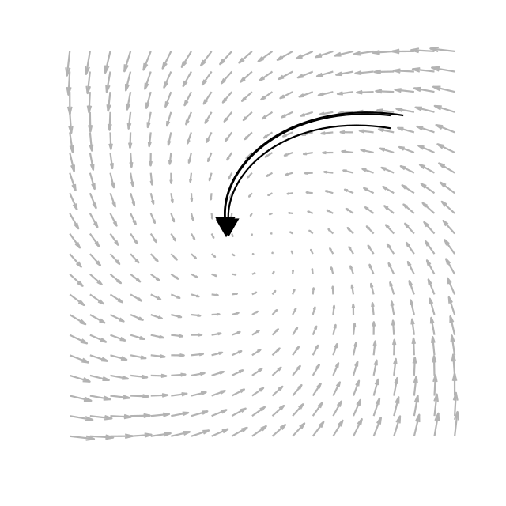
Varieties of dynamical system
Autonomous
Smooth
Linear
Rotational
Notes:
or contract – that is, overall firing rates can trend upward or downward. States can also rotate – that is, neurons exhibit transient increases or decreases in firing rate but ultimately return to the same state.

Slide 13
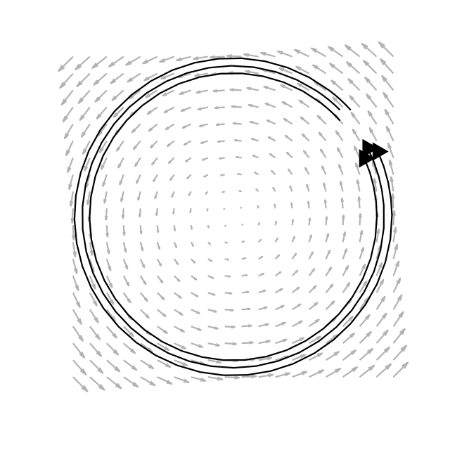
Varieties of dynamical system
Autonomous
Smooth
Linear
Rotational
Notes:
And finally, Rotationality: Rotational dynamical systems comprise a subset of linear dynamical systems, namely those whose states are restricted to just “rotating,” or waxing then waning.

Slide 14
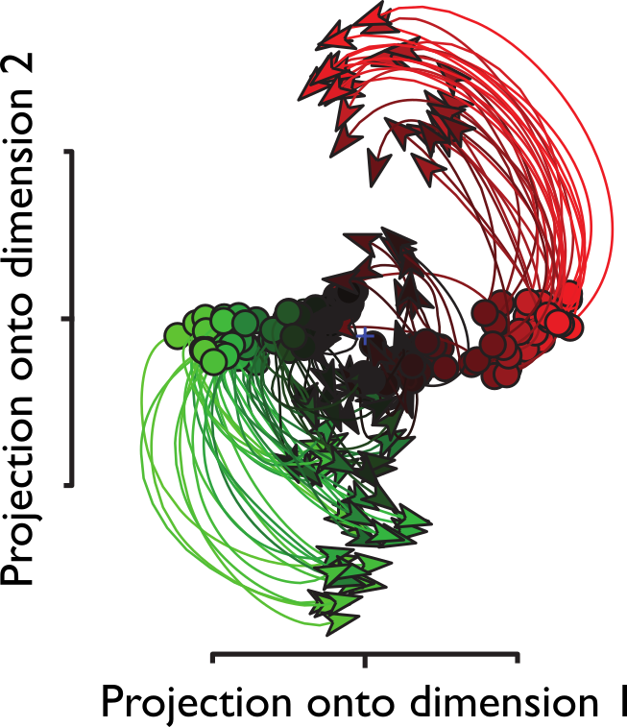
Rotational structure in neural populations
Churchland, Cunningham,
et al. 2012 Nature
Notes:
Using these methods, people have shown that much of the population activity in M1 during reaching follows rotational dynamics.
Shown here are reduced-dimensional patterns of neural activity that follow remarkably consistent circular paths, where each trace is neural activity during a particular reaching condition.
Rotational dynamics here were isolated using a method called jPCA, which isolates rotational components of neural activity.
WICHTIG!!!!!: To return to the fundamental question: this remarkable structure in the response is consistent with the idea that M1 functions as a pattern generator, whose own intrinsic dynamics coordinate spatiotemporal patterns of activation.

Slide 15
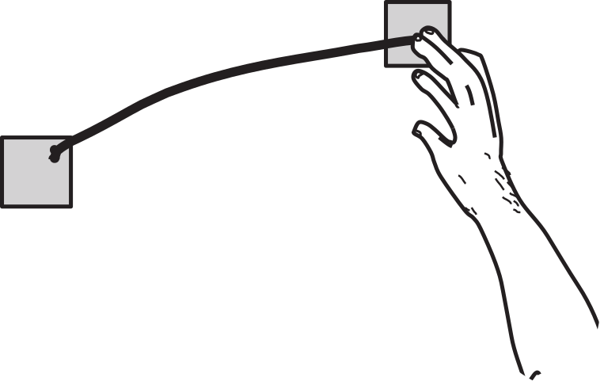
Primarily seen during reach
Notes:
However, these rotational dynamics have been observed for reaching movements. We were interested in assessing whether the same kind of neural dynamics might give rise to other movements.

Slide 16
Primarily seen during reach
Notes:
In our lab, we have a particular interest in the hand, which differs in a variety of ways from the arm.

Slide 17
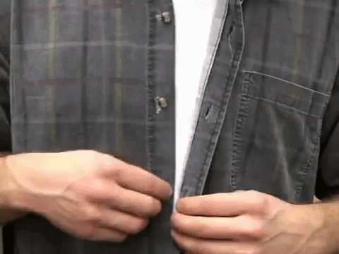





The versatile hand
Notes:
Indeed, hands are tasked with performing a wide variety of things, as pictured here, including a form of dance shown in the bottom-right known as finger tutting.
Does M1 show similar dynamical structure for the control of the hand as it does the arm?
Bottom-middle: “sign with Robert”
Bottom-right: Jayfunk, architect of Dr. Strange’s stuff

Slide 18
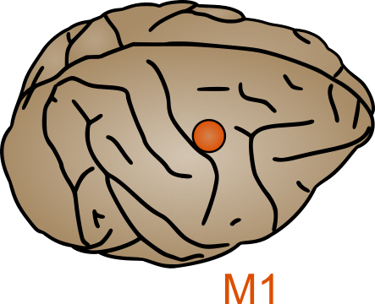
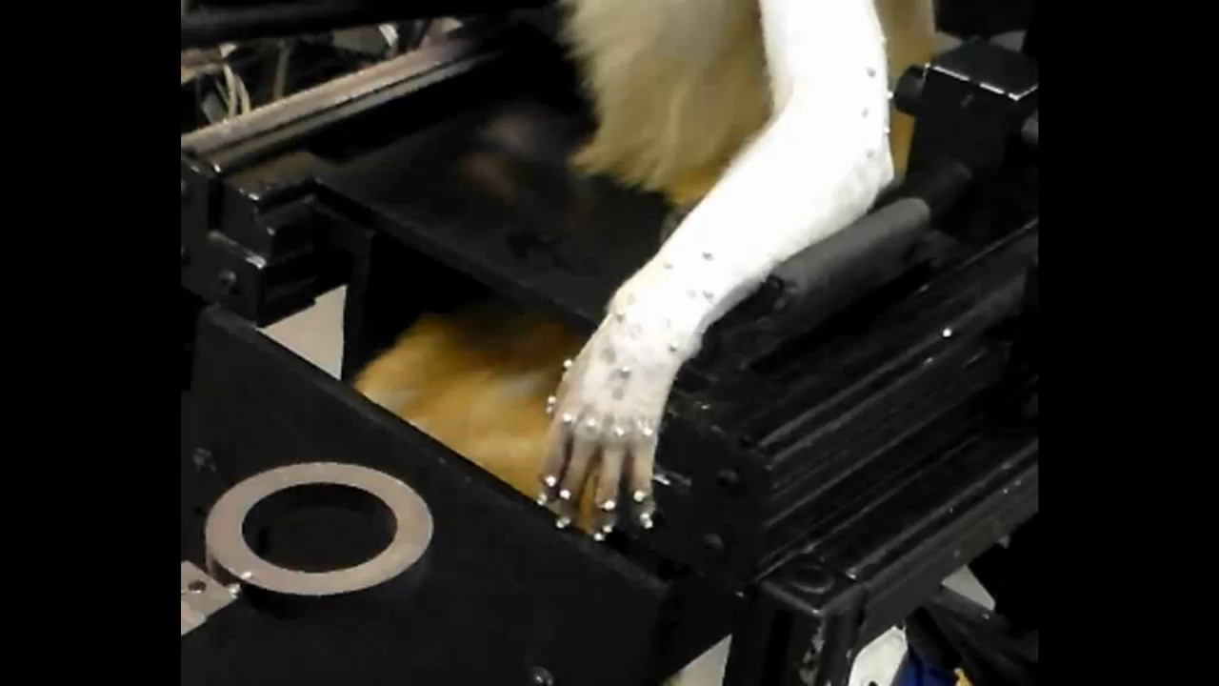
Grasp experiment
Notes:
To begin to answer this question, we recorded from populations of neurons in motor cortex while monkeys grasped objects spanning a variety of different shapes, sizes, and orientations.
Importantly, the objects were brought to the animal’s hand to restrict reaching and isolate grasp-related activity. Moreover, we analyzed only the population activity before contact was initiated with the object.

Slide 19
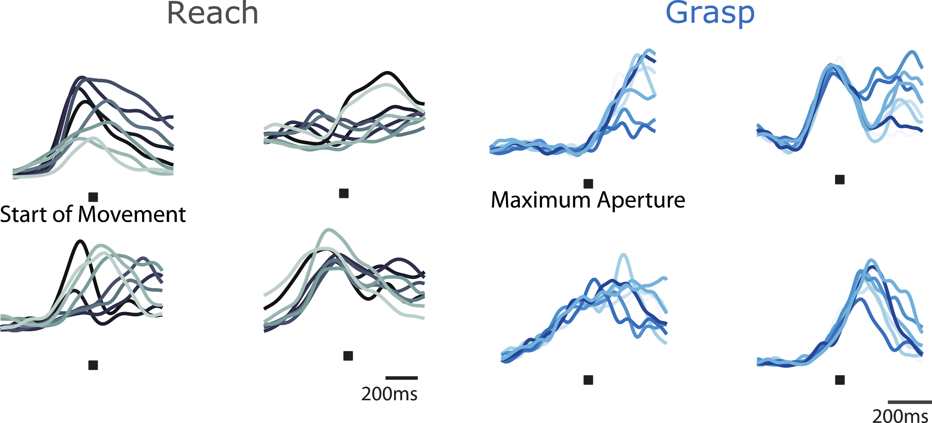
Single-neuron responses during reach and grasp
Best, et al. 2016 Cerebral Cortex
Notes:
We compared the grasp-related responses to their reach related counterparts.
The responses during reach and grasp – each trace corresponds to a different reach direction or a different grasped object – offer no indication that the population structure of M1 activity should differ across these two tasks.

Slide 20
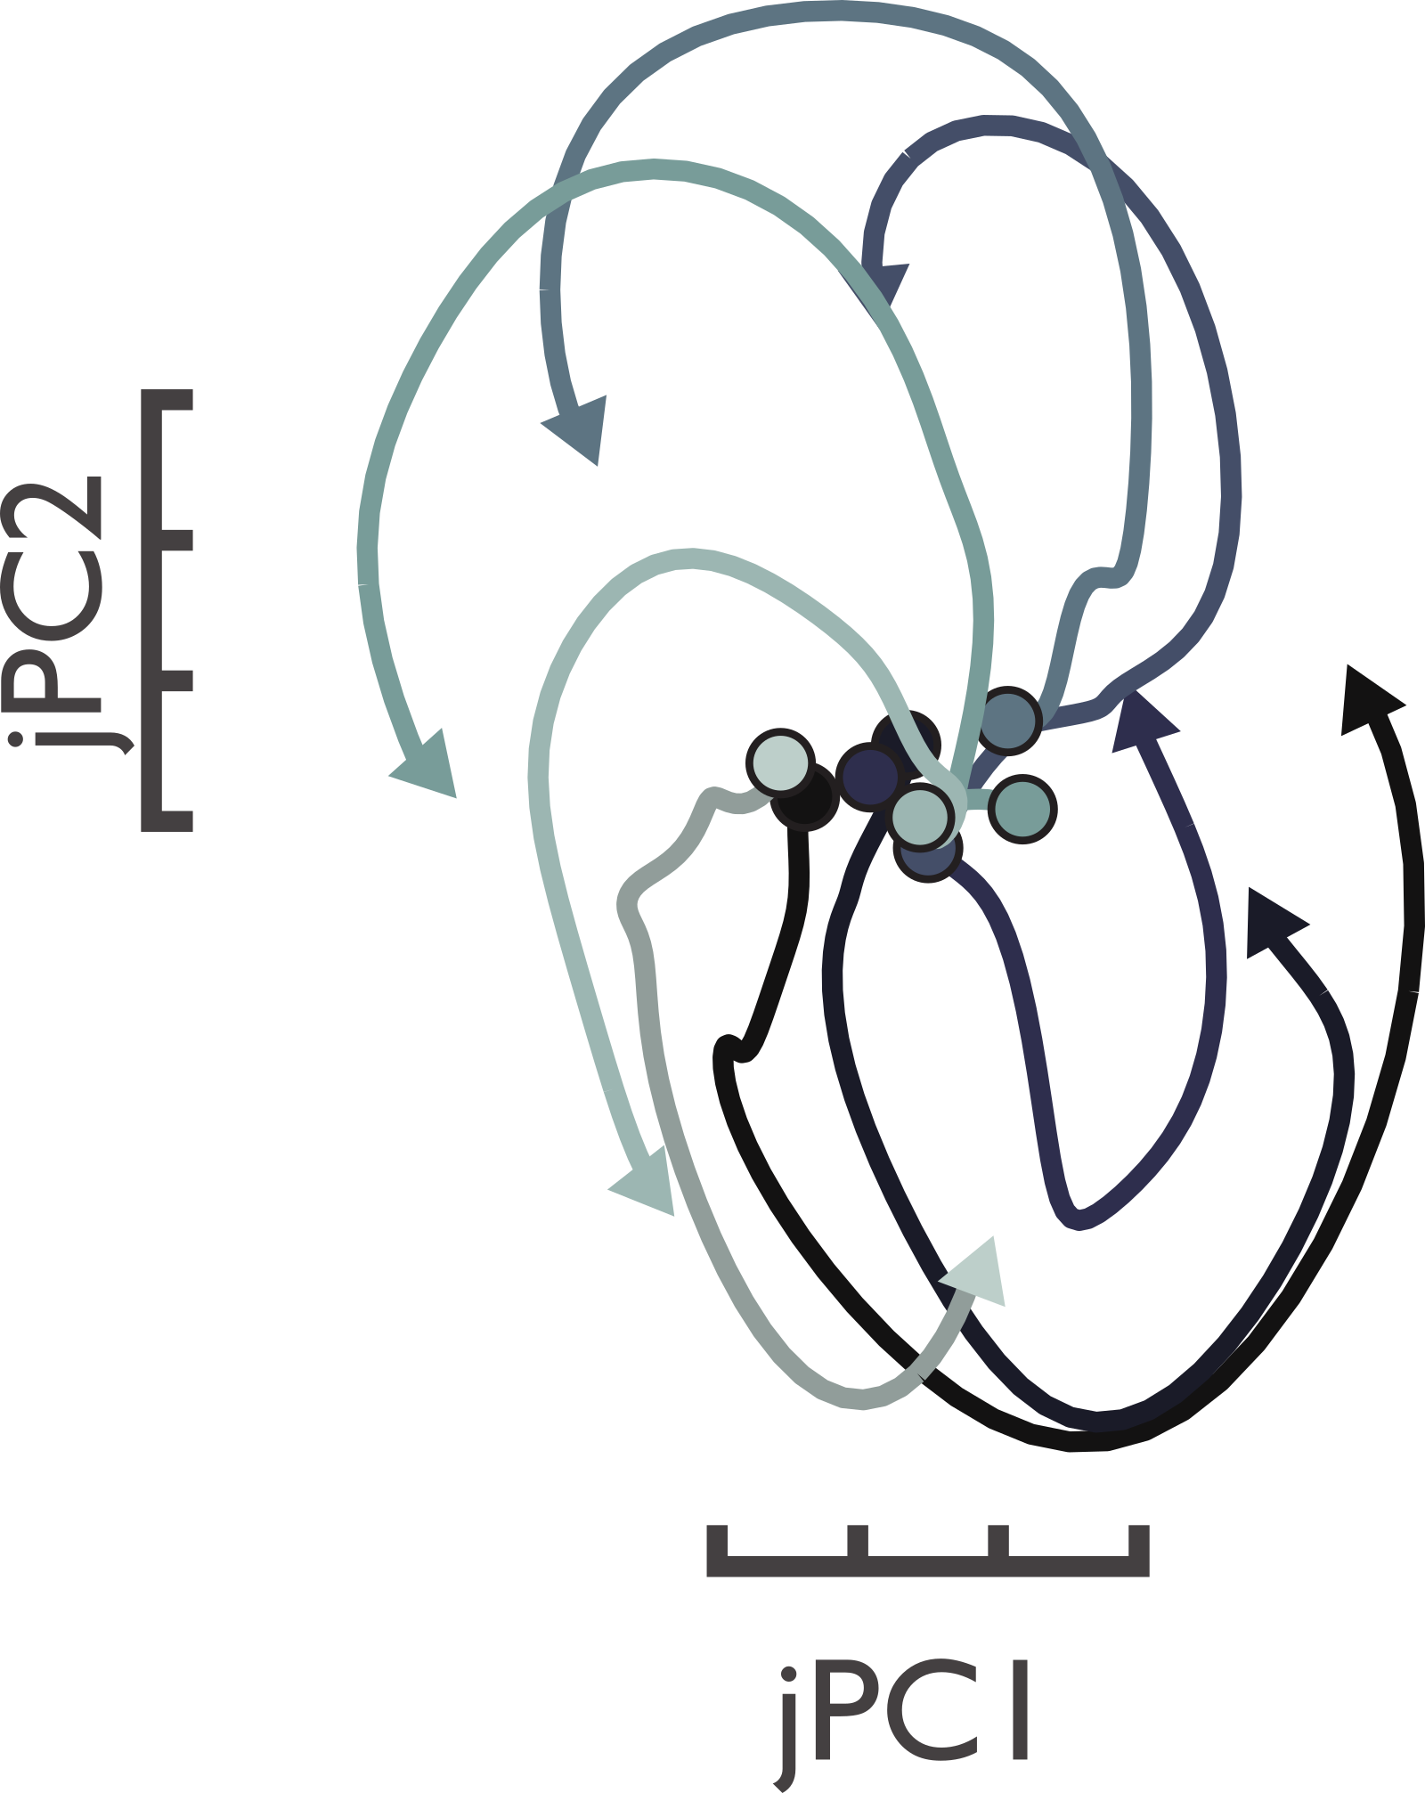
Rotational structure during reach
Notes:
So, we turn to population-level analyses to seek dynamical structure, starting with jPCA.
Indeed, during reach, we find the emergence of similar circular trajectories as has been shown before.

Slide 21
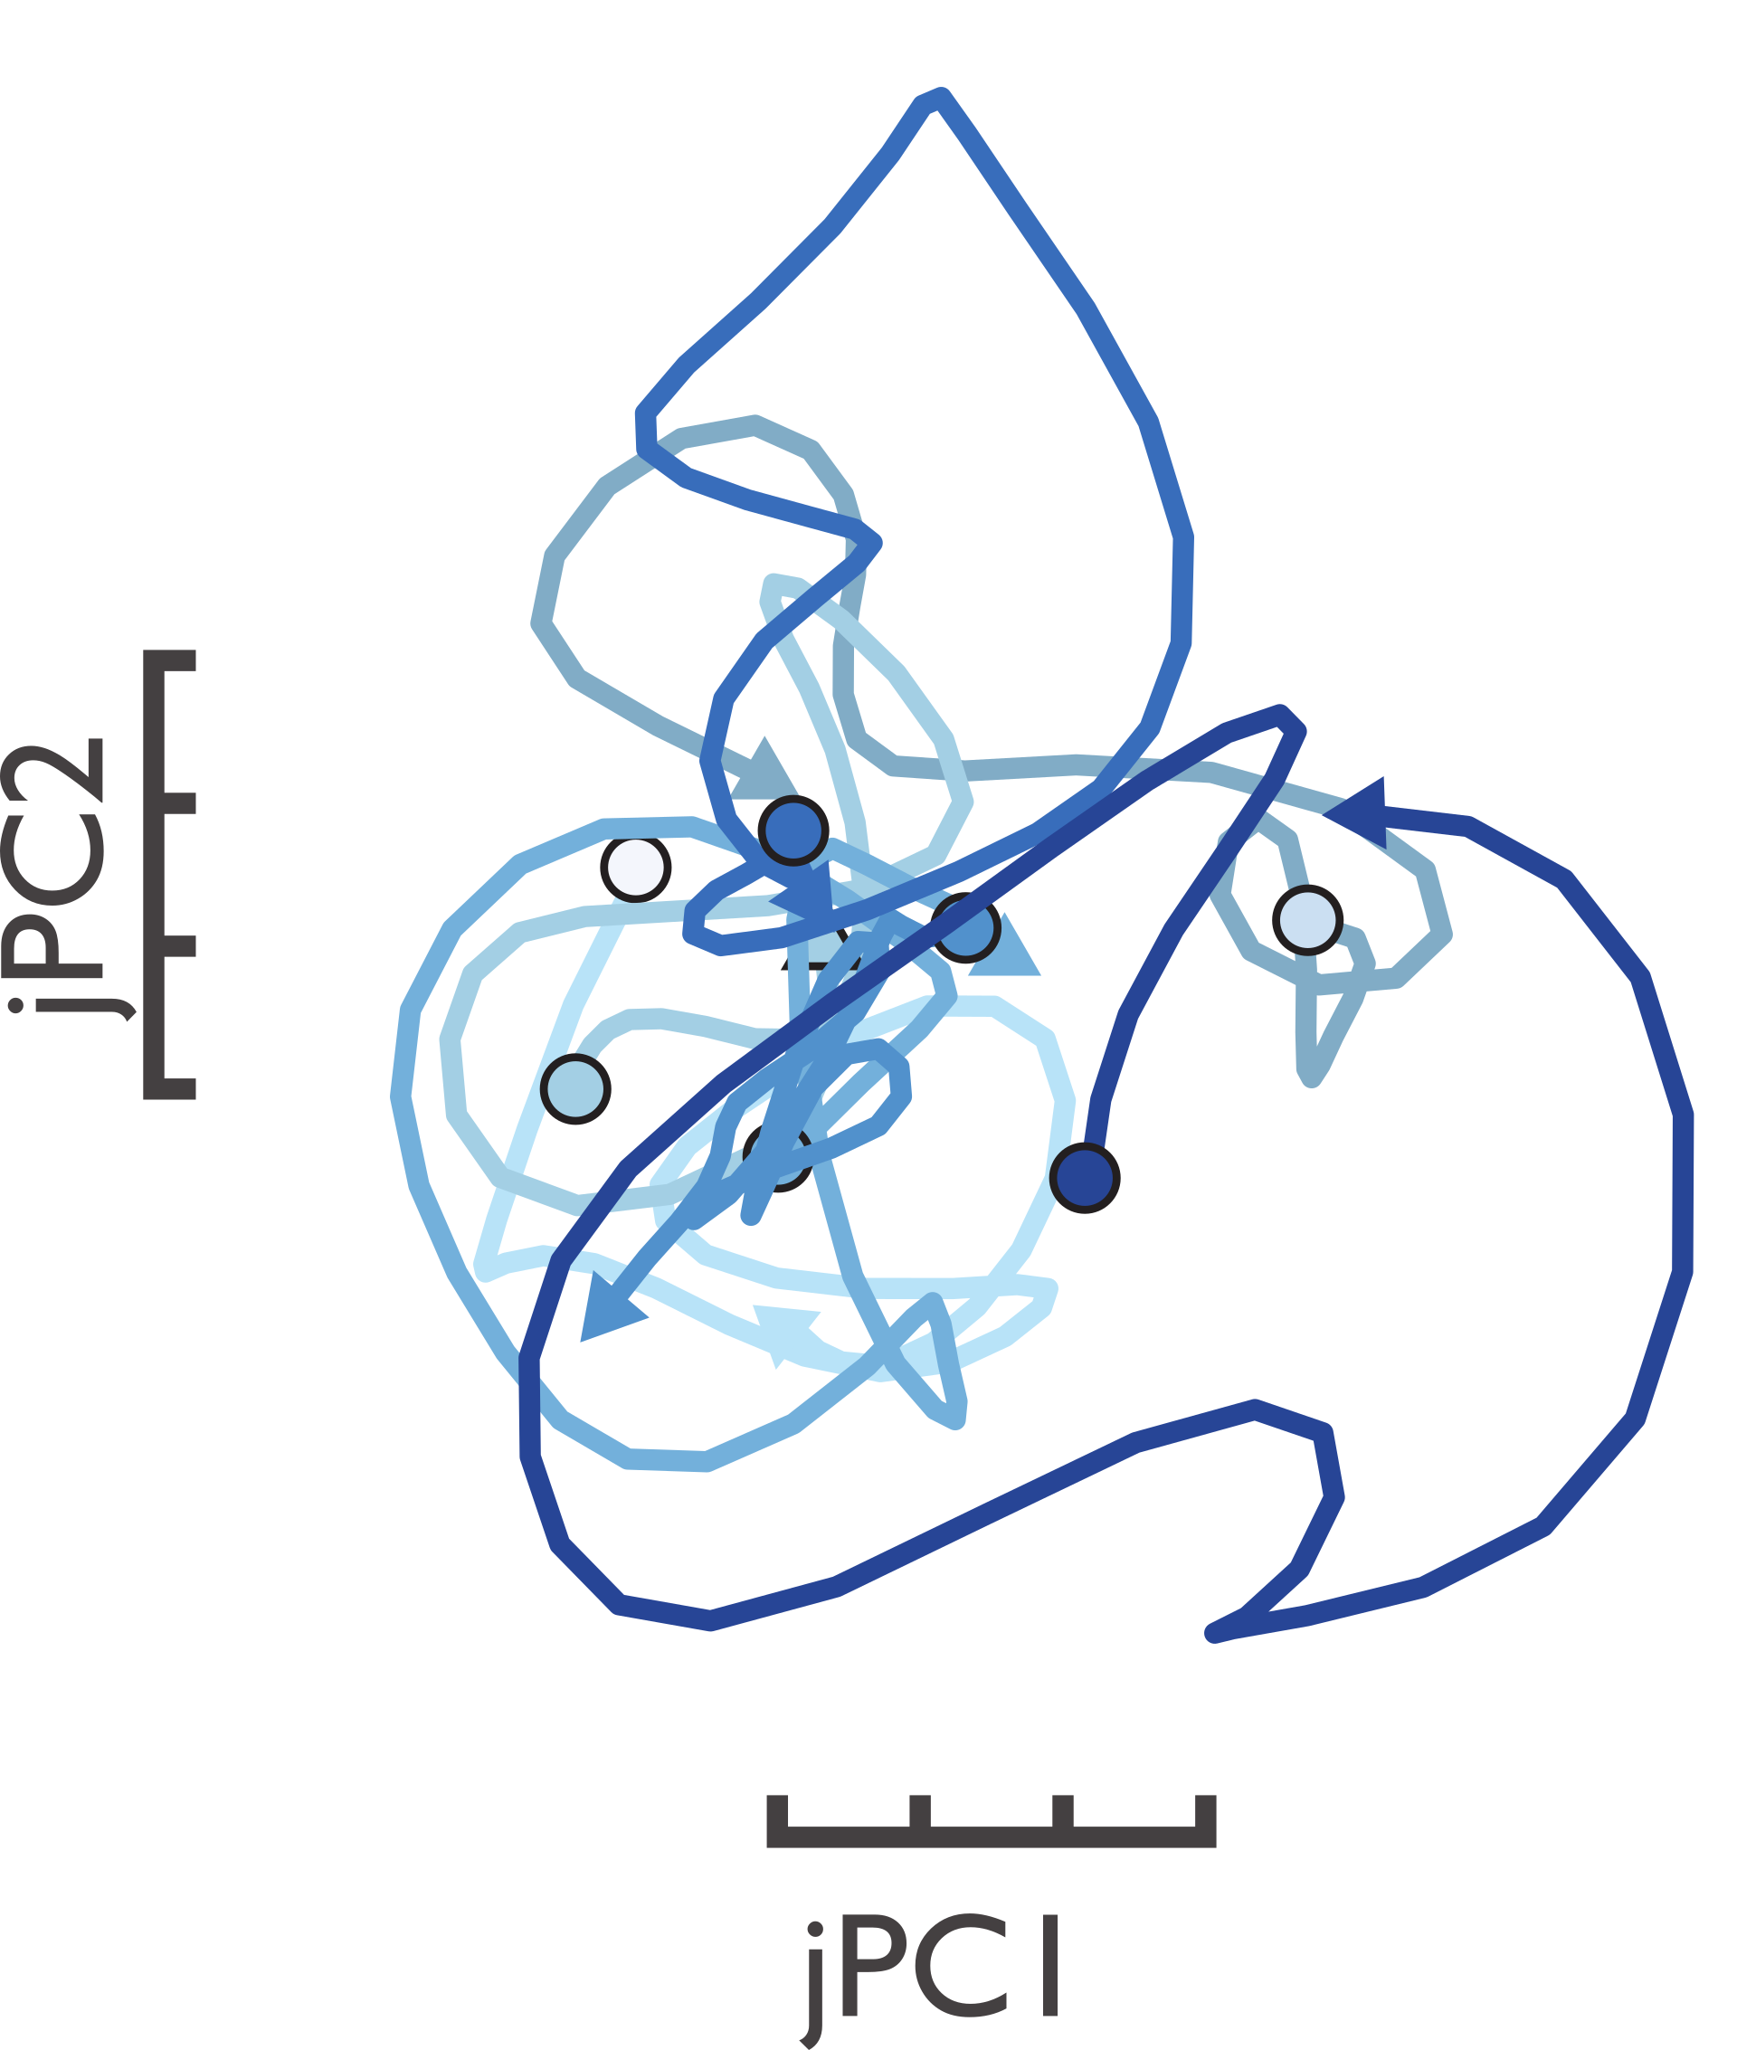
No clear structure during grasp
Notes:
However, during grasp, rotational structure is nowhere to be found, despite the seeming similarity of the response at the single-cell level.

Slide 22
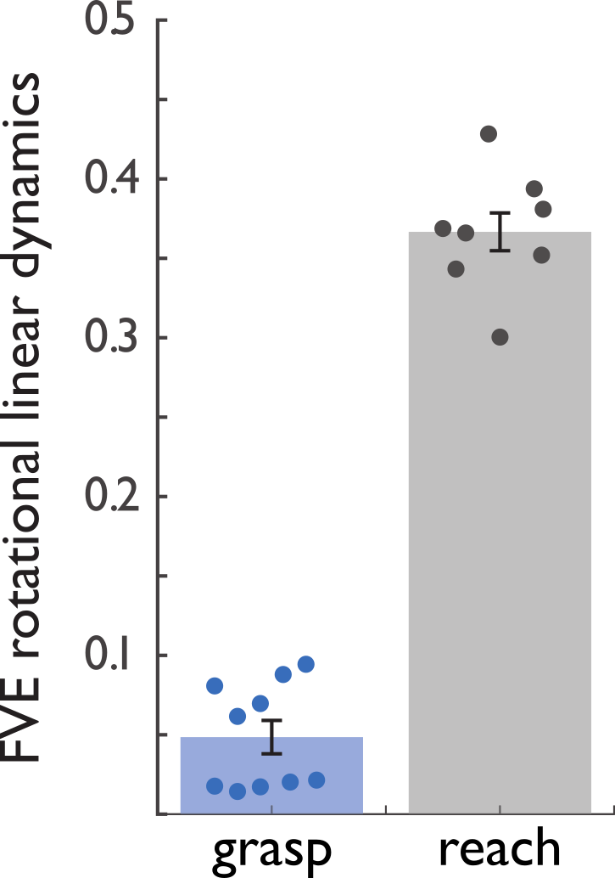
Variance explained by rotational dynamics
Notes:
When we quantify the degree to which population responses follow rotational trajectories, we find that a large fraction of the variance in the response can be accounted for by rotational dynamics for reach but not for grasp.

Slide 23
Varieties of dynamical system
Autonomous
Smooth
Linear
Rotational
Notes:
Okay, so it appears that M1 activity does not exhibit rotational dynamics during grasp.
However, are we being too restrictive by assuming those dynamics have to be rotational? What if we allow them to be more generally linear?
*Tighten this. In such a case, activity would be permitted to wax and wane, but not restricted to return to its initial state.

Slide 24
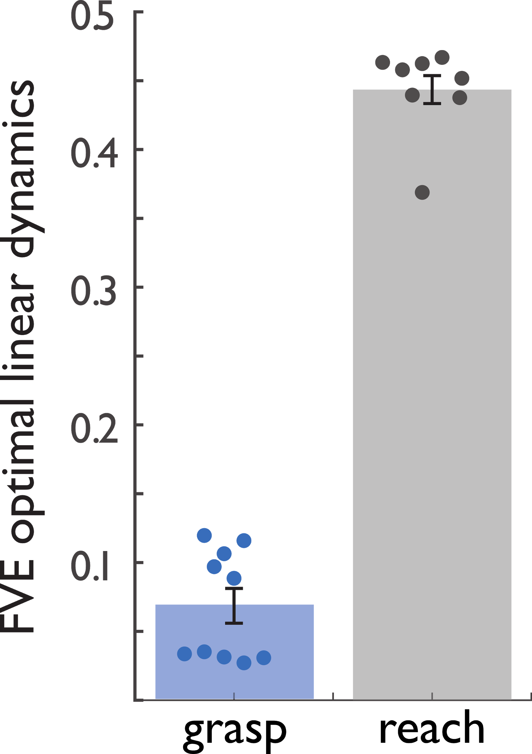
Variance explained by linear dynamics
Notes:
We can test this possibility by fitting a linear dynamical system to the population activity…
...but again, we find this model provides a poor fit to the data. The future neural state can be predicted from the current state using a linear model for reach, but not for grasp.

Slide 25
Varieties of dynamical system
Autonomous
Smooth
Linear
Rotational
Notes:
Okay, so M1 dynamics do not appear to be linear during grasp even though they are during reach.
*Tighten this: Perhaps we are still being too restrictive. Perhaps the dynamics are nonlinear, but if they are at least smooth, such dynamics would be predictable and, thus, be good for pattern generation.

Slide 26
A metric of “tangling”
High tangling
Low tangling
Russo, et al. 2018 Neuron
Notes:
As I mentioned earlier, in any smooth dynamical system, similar current states should give rise to similar future states. A metric has been developed, known as “tangling”, that measures the extent to which nearby states are associated with different derivatives. The more dissimilar are the derivatives at similar states, the more “tangled” (and thus less smooth) is the system. This metric does not require the dynamics to be linear.

Slide 27
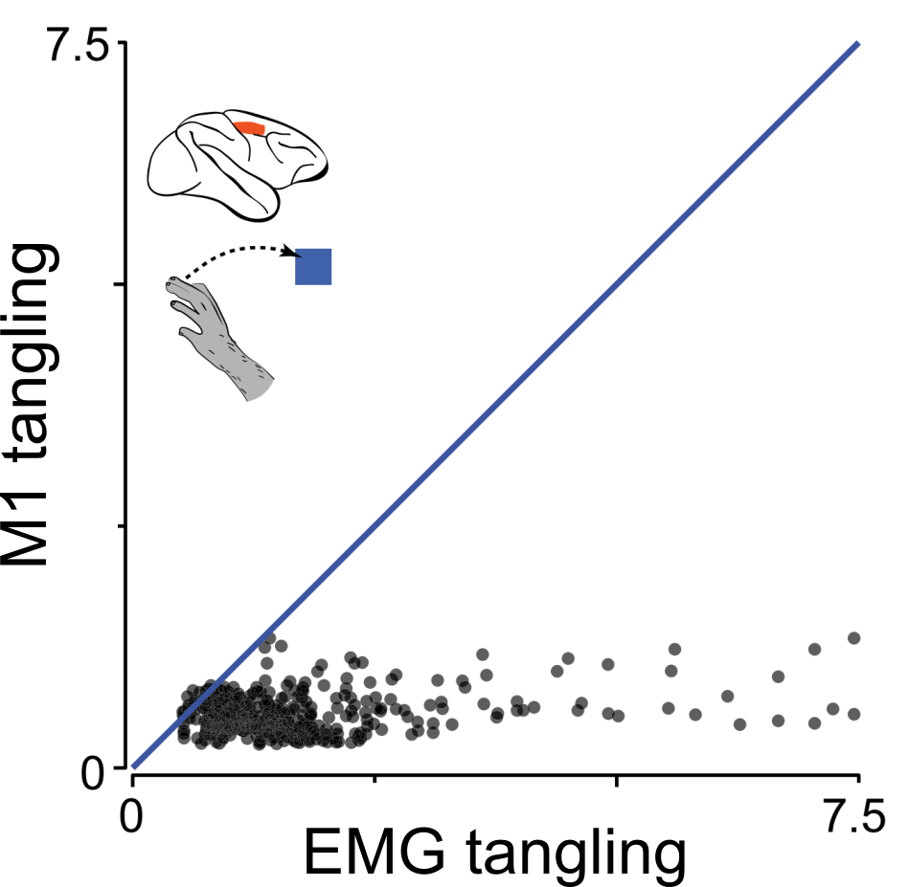
M1 activity during reaching is untangled
Russo, et al. 2018 Neuron
Notes:
Indeed, folks have applied this metric to M1 responses and EMG activity during reach. Muscle activations are not expected to exhibit intrinsic dynamics since they are driven by input from M1. Indeed, we see that M1 activity is substantially less tangled than the EMG activity.

Slide 28
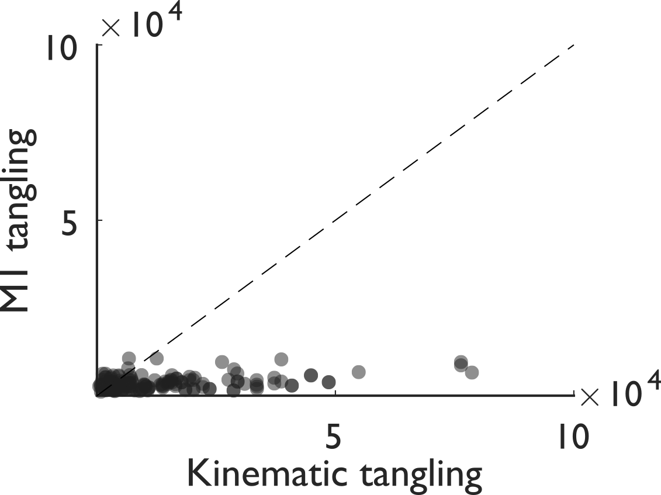
M1 activity during reaching is untangled
Notes:
And when we apply this analysis to our own reaching data, using Kinematics as a proxy for EMG activity, we find a similar story: M1 during reach exhibits smooth, intrinsic dynamics, good for pattern generation.

Slide 29
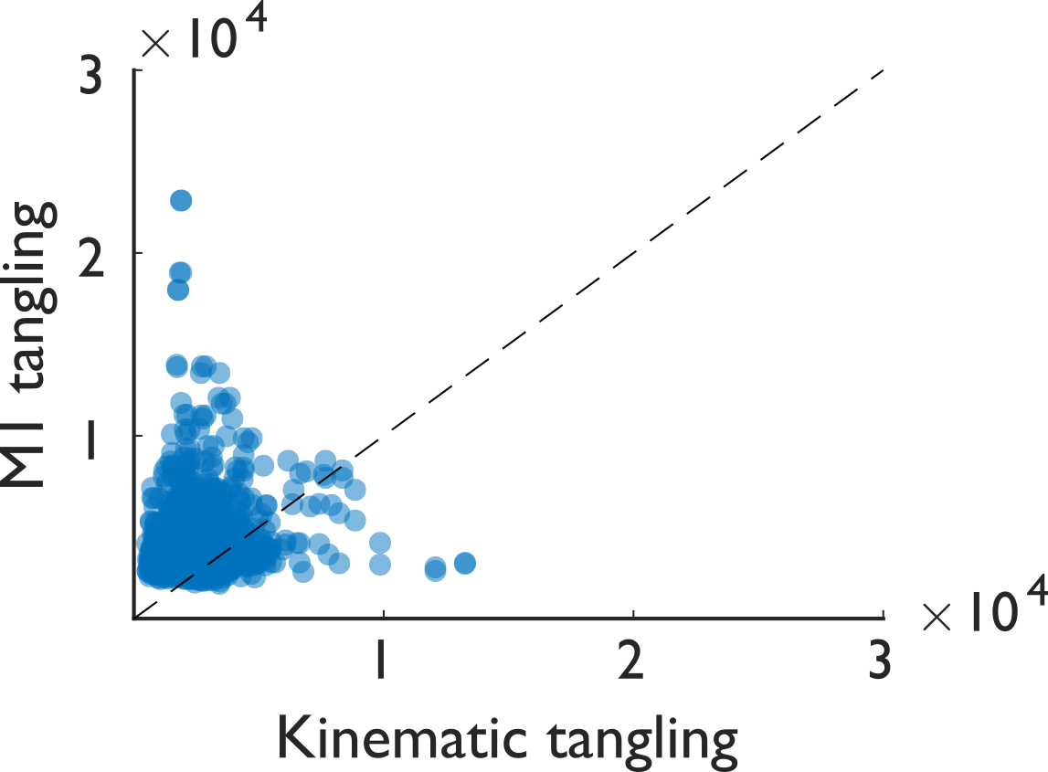
During grasp, M1 activity is very tangled
Notes:
However, during grasp, the same analysis reveals no such relationship between M1 and the hand: if anything, M1 activity appears more tangled than the grasping kinematics.

Slide 30
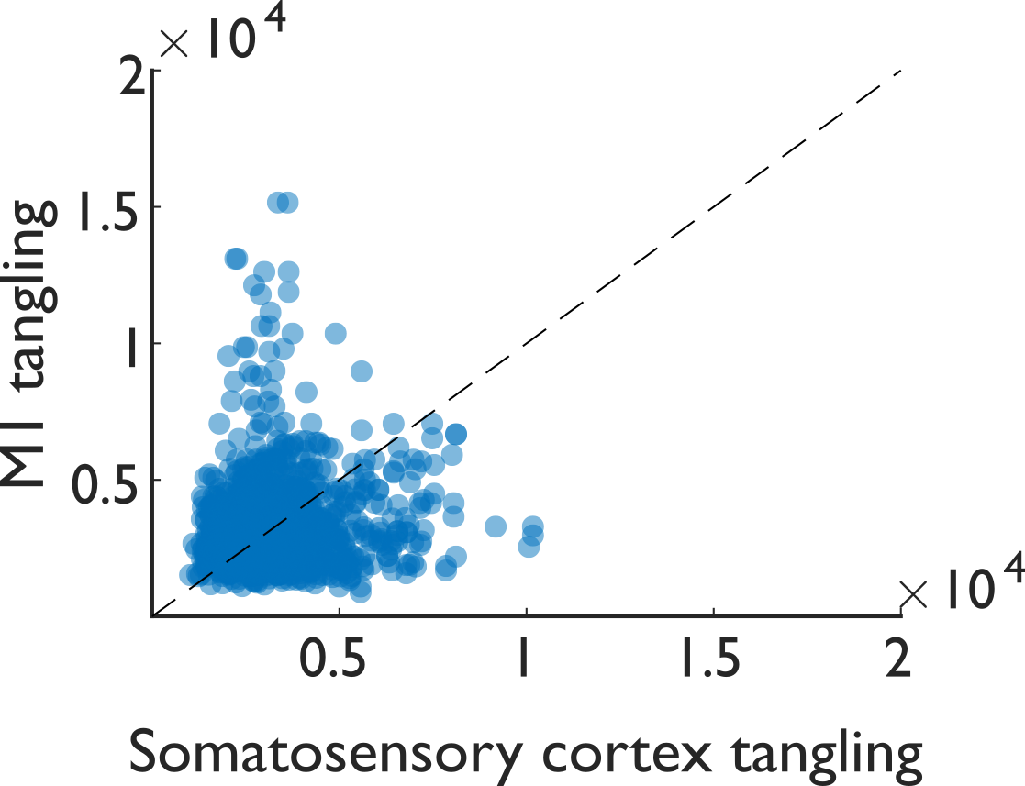
M1 and sensory cortex similar during grasp
Notes:
Moreover, we also recorded from somatosensory cortex during this task, and when we apply this analysis to the population activity in sensory cortex, we find it to be just as tangled as its M1 counterpart.
This is surprising: M1 dynamics during grasp just aren’t the same sort of smooth, autonomous dynamics that are seen during reach.

Slide 31
Varieties of dynamical system
Autonomous
Smooth
Linear
Rotational
Notes:
Tighten: So, what gives? We don’t observe rotational, linear, or even smooth dynamics during grasp in contrast to reach. The only thing remaining to consider is whether these dynamics are autonomous or not.

Slide 32
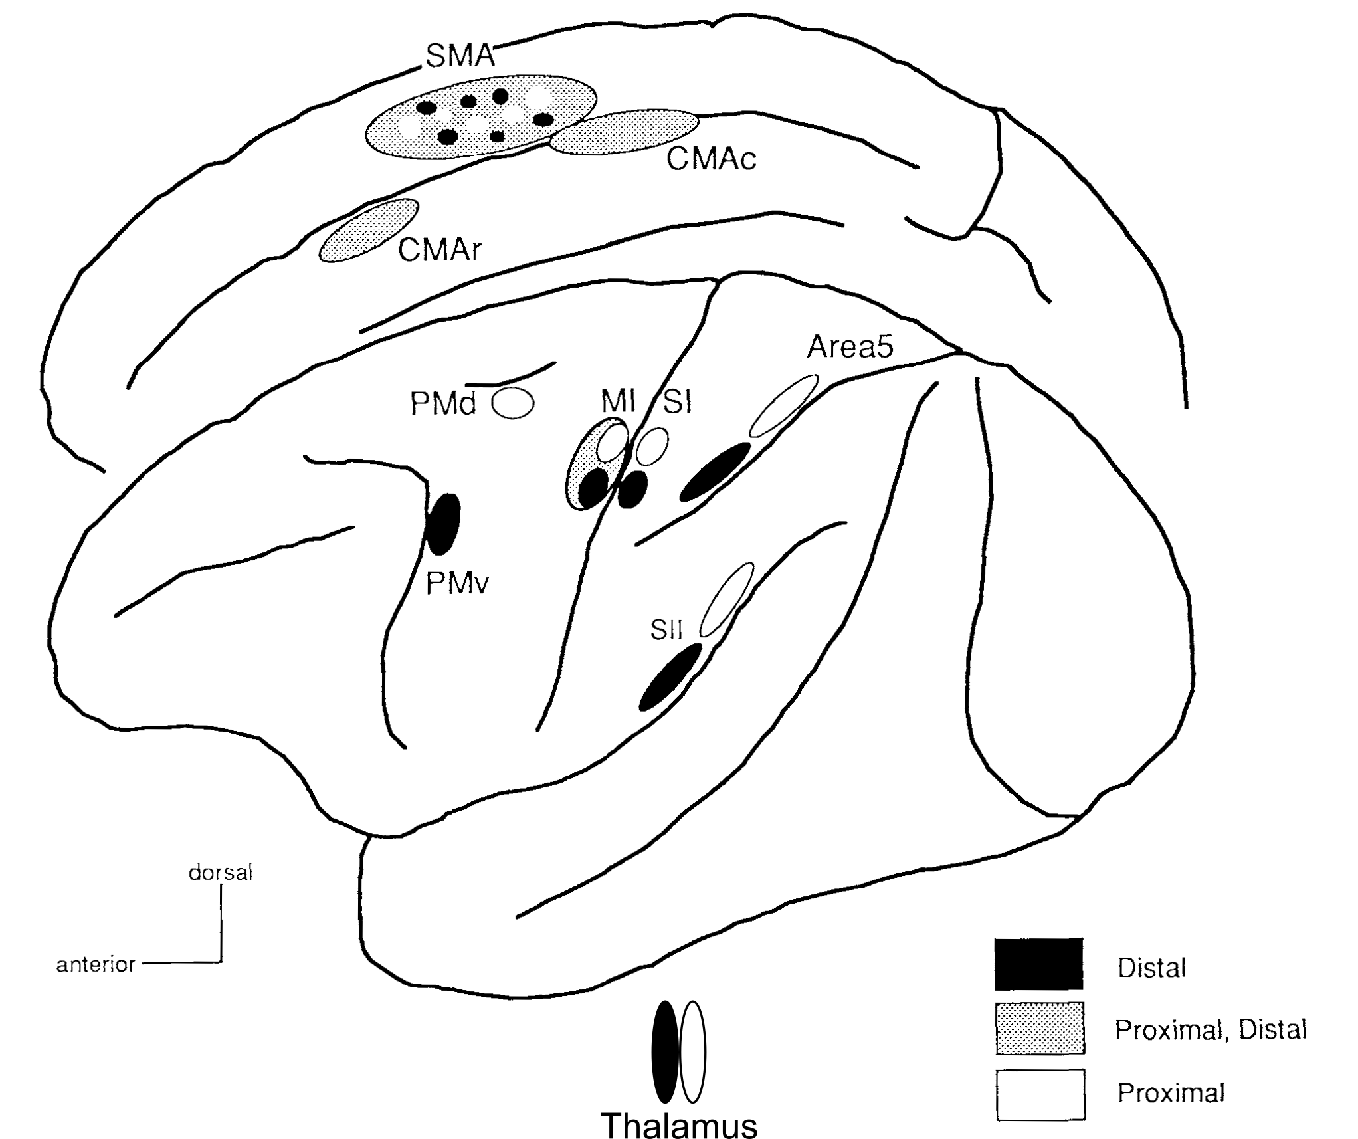
Non-autonomous dynamics
Tokuno & Tanji 1993 J Comp Neurol
Notes:
Tighten: It’s very likely that M1 activity is not autonomous during grasp. Indeed, it’s well-established that M1 receives a wide array of input from all over the nervous system. Perhaps the autonomous dynamics of M1 are more distorted by these inputs during grasp than during reach.

Slide 33

Non-smooth, non-linear dynamics
Notes:
Tighten: Alternatively, what we see could be the emergence of an autonomous, but non-smooth, non-linear generator during grasp, trading the predictability of a smooth generator for the flexibility and sensitivity of a non-smooth one.
These possibilities are not mutually exclusive, so both could be at play, or even other factors that we have yet to consider (although perhaps somebody in the audience has considered such factors).

Slide 34
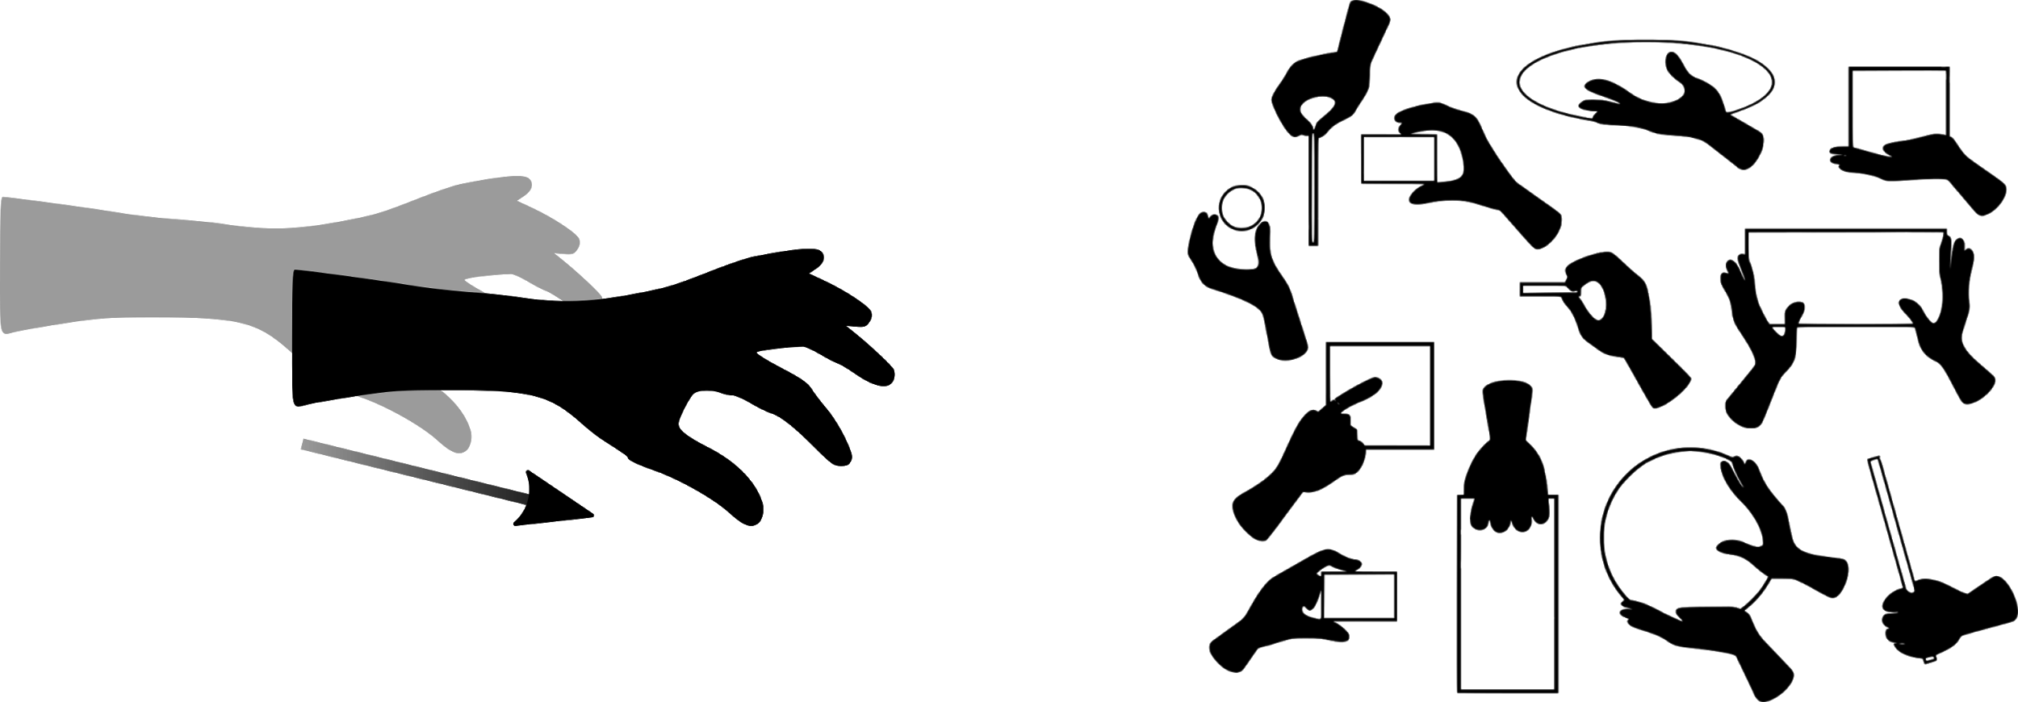
Distinct movements, distinct dynamics
Notes:
Regardless, reaching and grasping are associated with distinct patterns of population-level activity, calling into question whether smooth, autonomous dynamics are a universal property of M1 activity.

Slide 35


Acknowledgments
Aneesha Suresh, Elizaveta Okorokova
Matthew Kaufman, Nicholas Hatsopoulos, Sliman Bensmaia
Gregg Tabot, Alex Rajan, Alex Lee
NS082865, NS101325, NS096952
Notes:
And with that, I’d like to thank:
The people who did all the analysis: Aneesha Suresh & Liza Okorokova
The people who helped guide the work: Matt Kaufman, Nicho Hatsopoulos, and my advisor Sliman Bensmaia
The people who helped collect the data: Gregg Tabot, Alex Rajan, and Alex Lee
And: Funding from the NIH, institutional support from the Grossman institute, and animal care support from the Animal Resources Center.

Slide 36
Supplemental slides
Notes:
Rouse & Schieber 2018 and Pandarinath et al. 2015 parrying for the questions:
Rouse & Schieber: well that had a reach component, so there’s your answer.
Pandarinath: that was sort of a “reach-like” movement. We’re still trying to determine whether this is strictly an arm-vs-hand (effector) or reach(-like)-vs-grasp (function) thing. Your results certainly imply the latter, though.
You BEST rehearse your answers to these!

Slide 37
Flavors of dynamical system
Autonomous
Smooth
Linear
Rotational
Nonlinear
Notes:
A fruitful way to tackle this question involves dimensionality reduction - methods such as PCA that compress multi-neuronal (high-dimensional) population information using just a few summary dimensions - and applying dynamical systems analyses to these low-dimensional summaries of population activity.
To briefly cover dynamical systems:
In a dynamical system, the state at the current time predicts what the state will be in the future. For our purposes, a “state” corresponds with the pattern of firing rates spanning an entire neural population.
There are many flavors of dynamical system, each exhibiting different properties. The properties we are concerned with are:
Autonomy: In an autonomous dynamical system, only the current state predicts what the state will be in the future - there are no other drivers of future state.
Smoothness: In a smooth dynamical system, similar states are associated with similar future states.
Linearity: In a linear dynamical system, states are restricted to some combination of “expanding” and “contracting” - wherein firing rates trend indefinitely downward or upward - and “rotating” - where neurons exhibit transient increases and decreases in firing rate but ultimately return to the same state.
Rotationality: In a rotational dynamical system, states are restricted to just “rotating”.

Slide 38
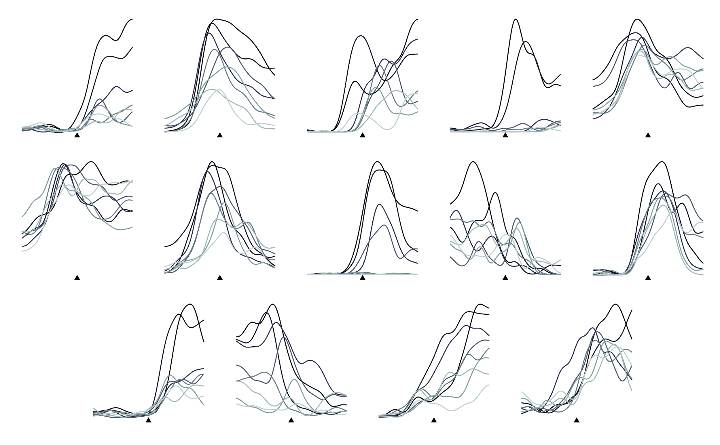
Single-neuron responses during reach and grasp
Notes:
We also consider data recorded during a center-out reaching task, and show here a set of single-neuron firing rate traces pooled from both of these tasks.
Indeed, to the naked eye, it’s difficult to differentiate one set of neurons from the other, offering no indication that anything substantially different should be happening in the population structure of M1 during these two tasks.
So, we turn to population-level analyses to seek dynamical structure, starting with jPCA.

Slide 39
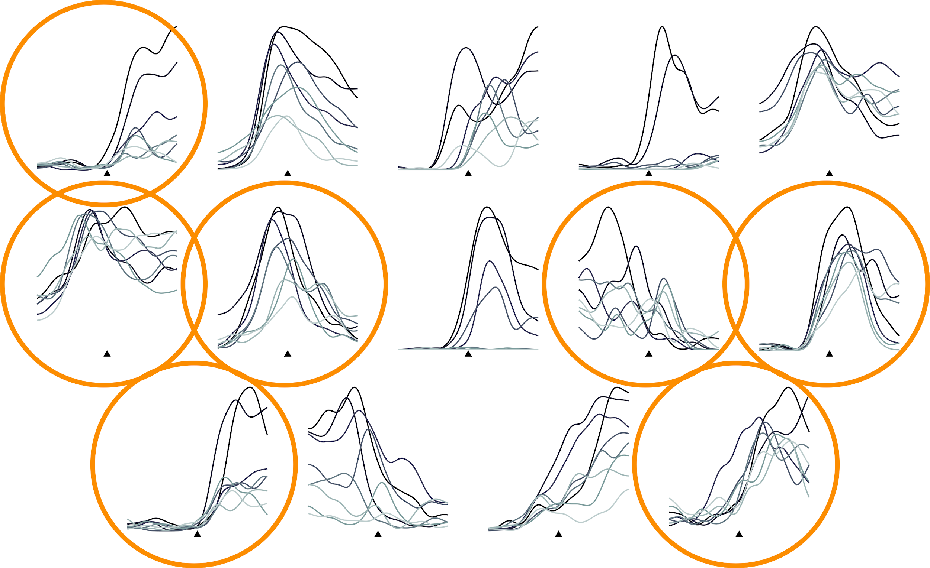
Single-neuron responses of reach and grasp
Notes:
We also consider data recorded during a center-out reaching task, and show here a set of single-neuron firing rate traces pooled from both of these tasks.
Indeed, to the naked eye, it’s difficult to differentiate one set of neurons from the other, offering no indication that anything substantially different should be happening in the population structure of M1 during these two tasks.
So, we turn to population-level analyses to seek dynamical structure, starting with jPCA.

Slide 40
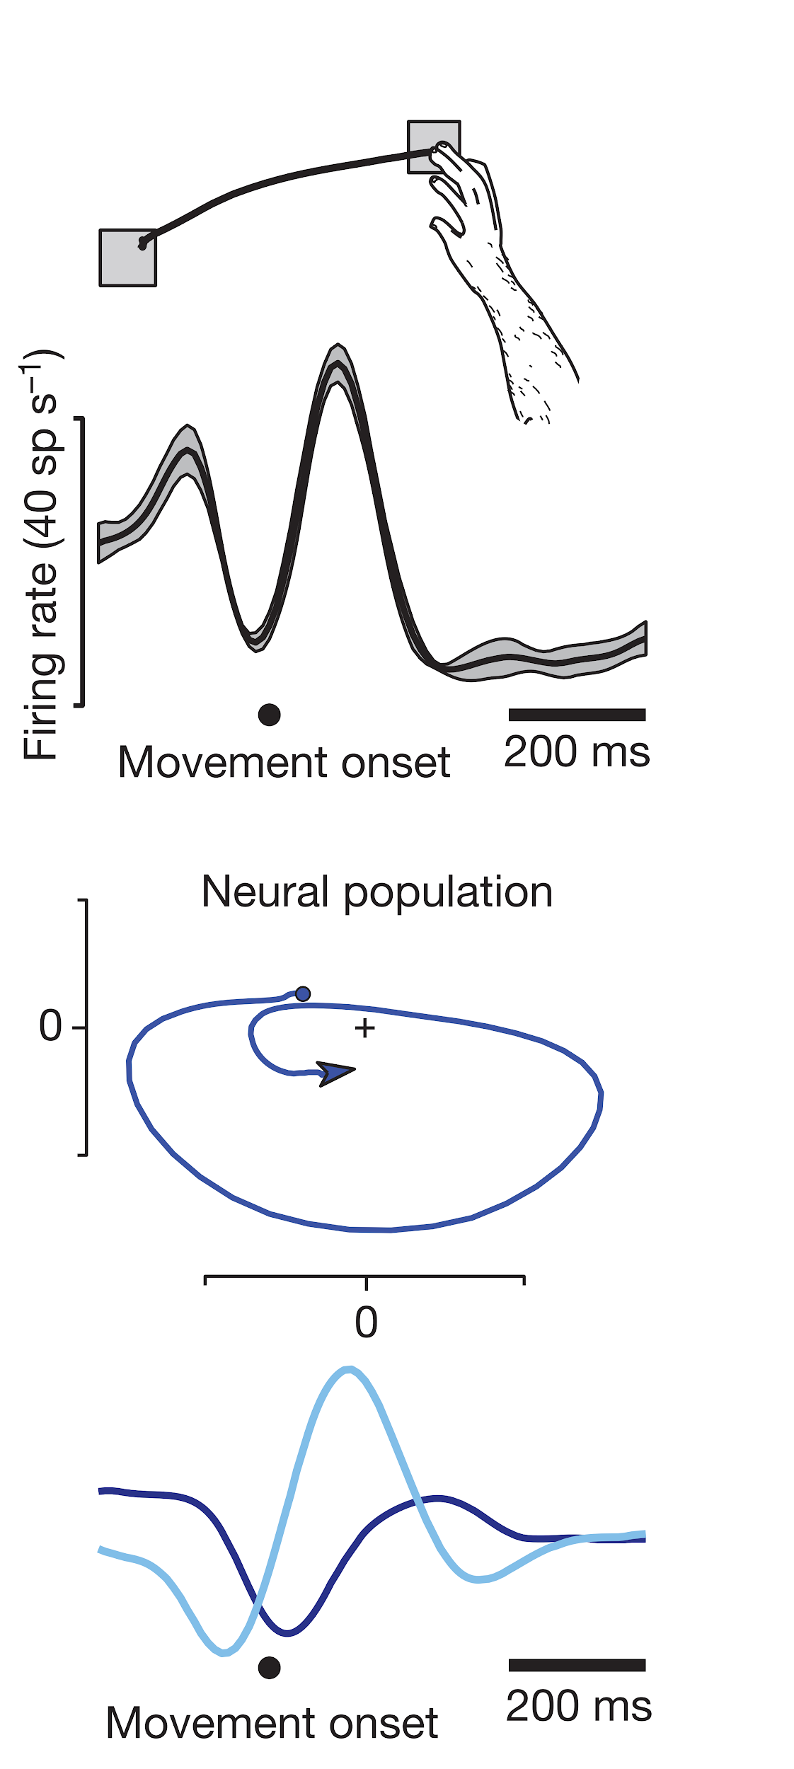
M1 as a simple dynamical machine
Churchland, Cunningham,
et al. 2012 Nature
Notes:
This slide is a nightmare. You’re trying to be too didactic! Don’t do it! Skipped.

Slide 41
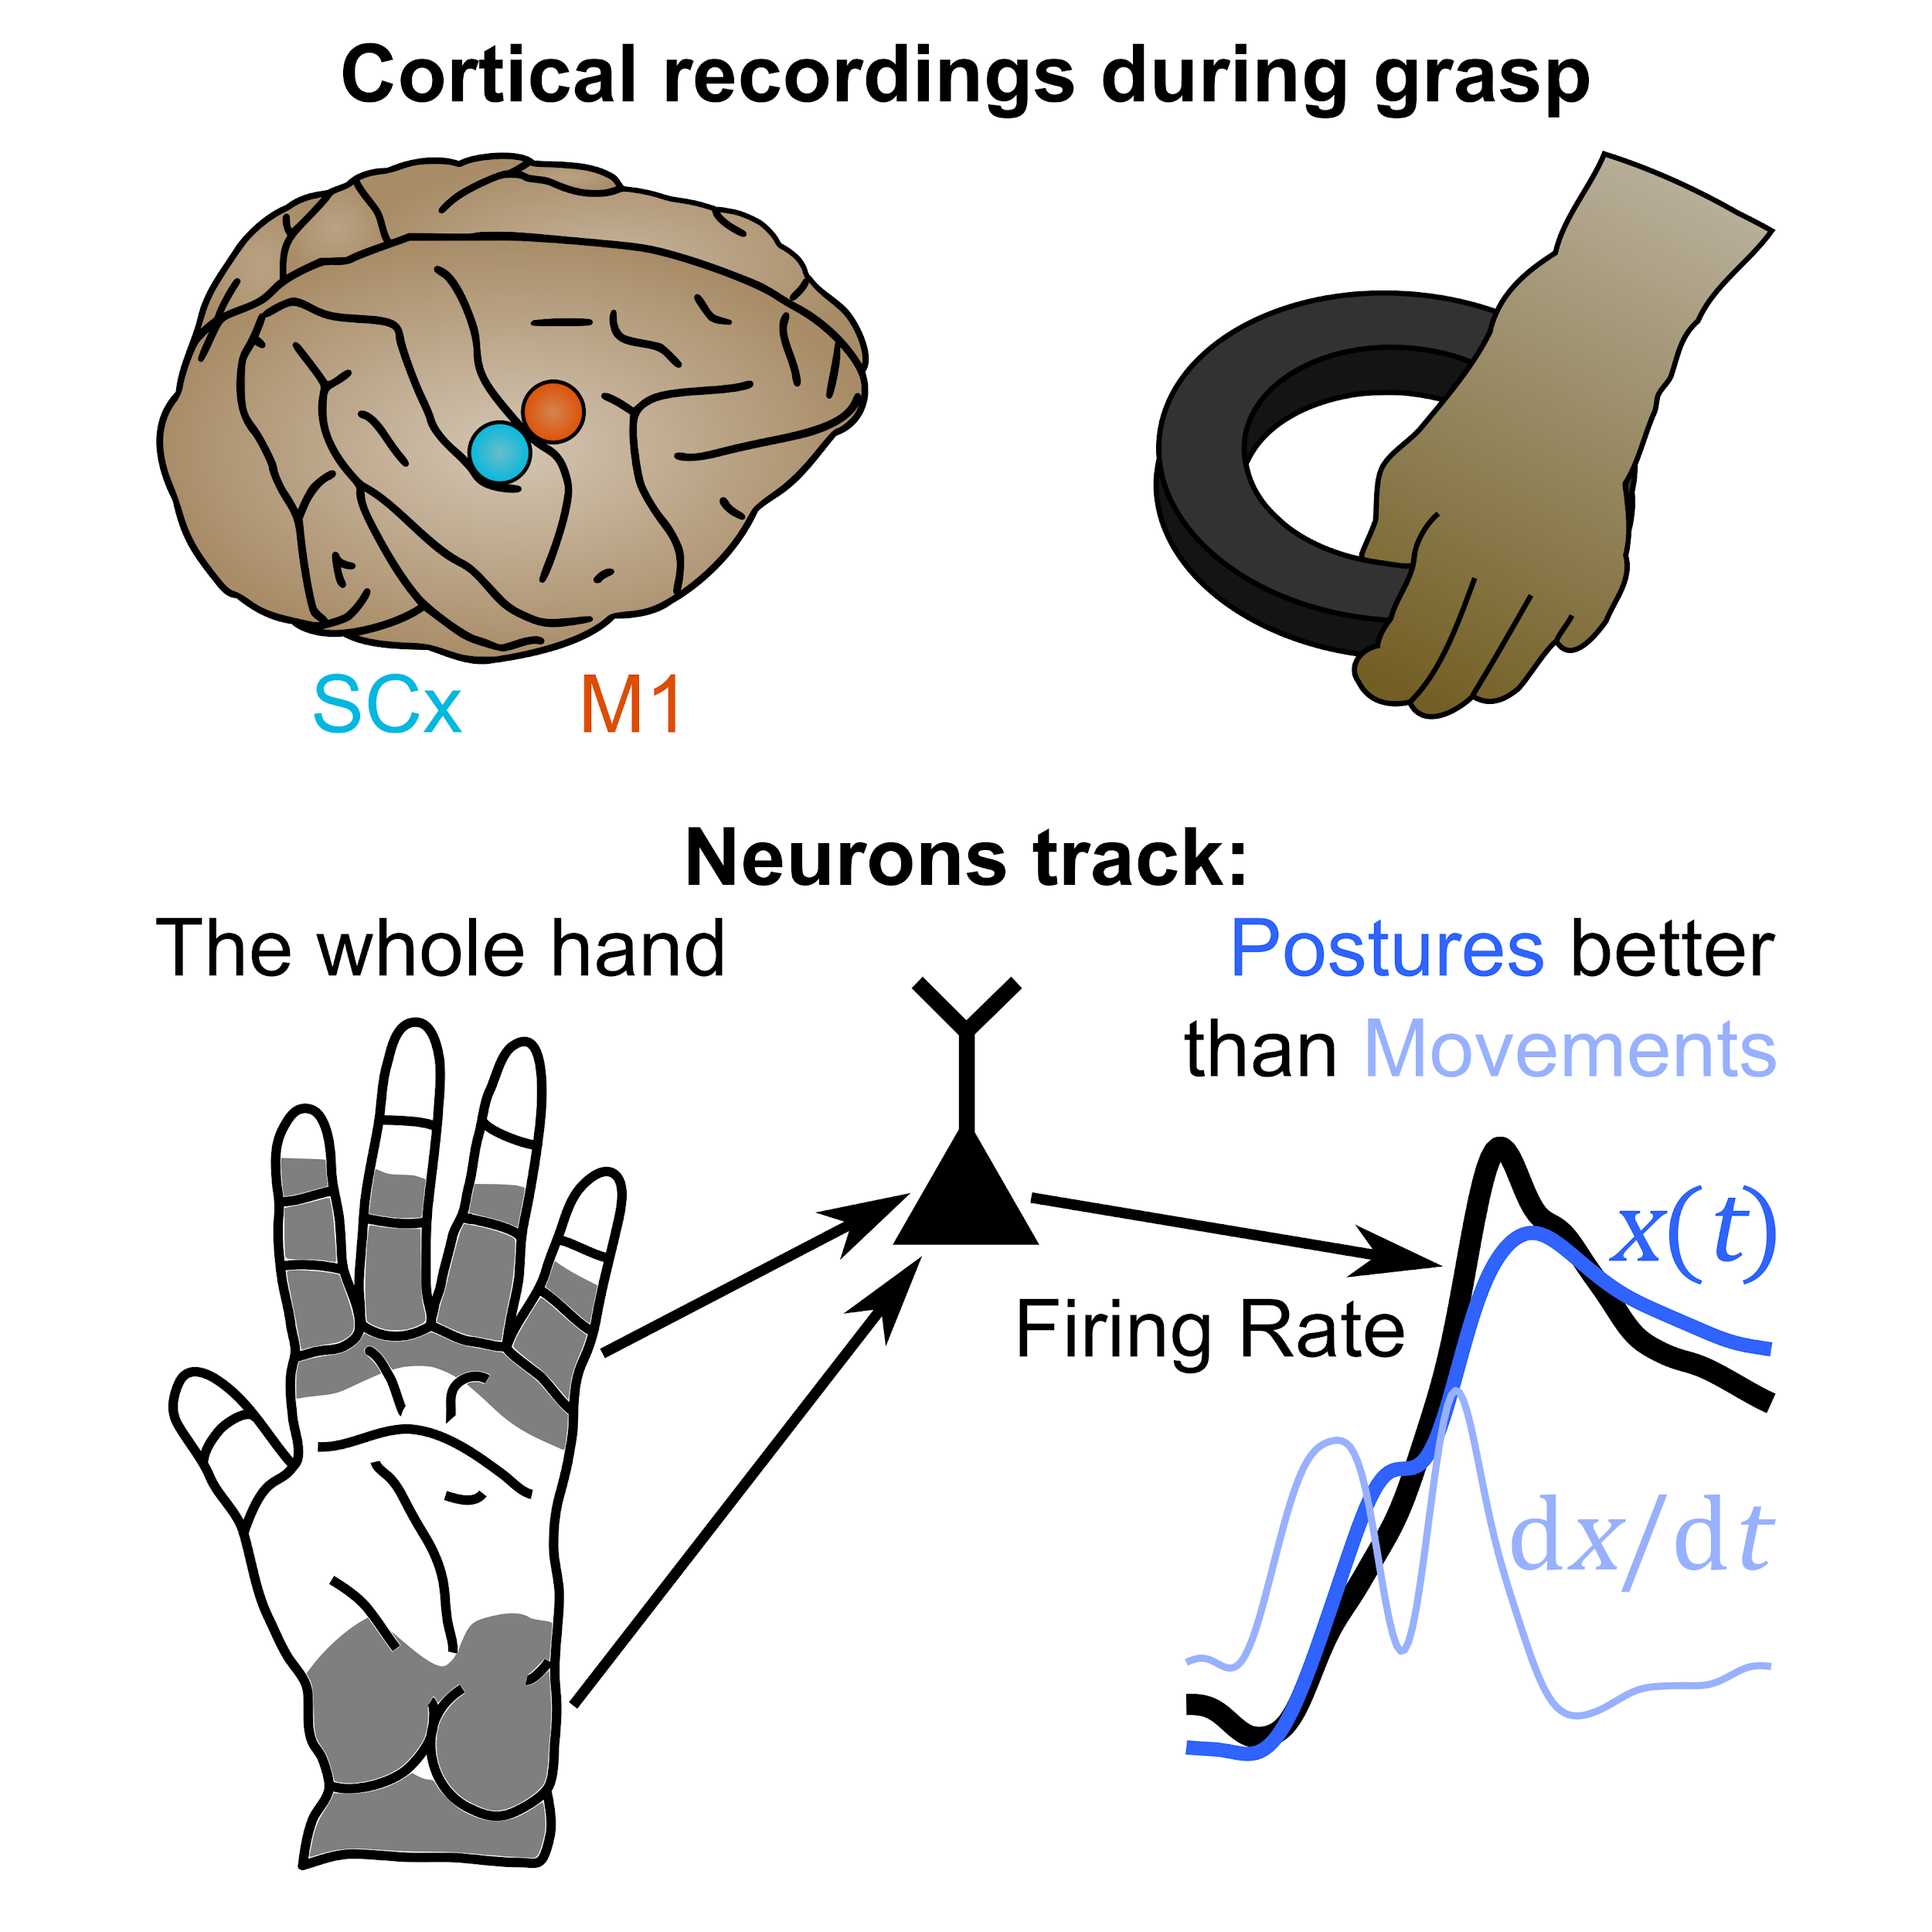
Hand & finger neural signals seem different, too
Goodman, et al. 2019 Neuron
Notes:
*at the single-neuron level
This visual abstract is… kinda goofy
I don’t like having to do it but mannn it’s the most concise way to explain these results (the heatmaps are the most striking but then I have to get into what the axes even mean, what models we used to fit things, yadda yadda yadda… just showing these traces is more likely to be intuitive)
Ugh the self shout-out is good for self-interest purposes, but it doesn’t add enough to the flow of THIS talk. Skipped.

Slide 42
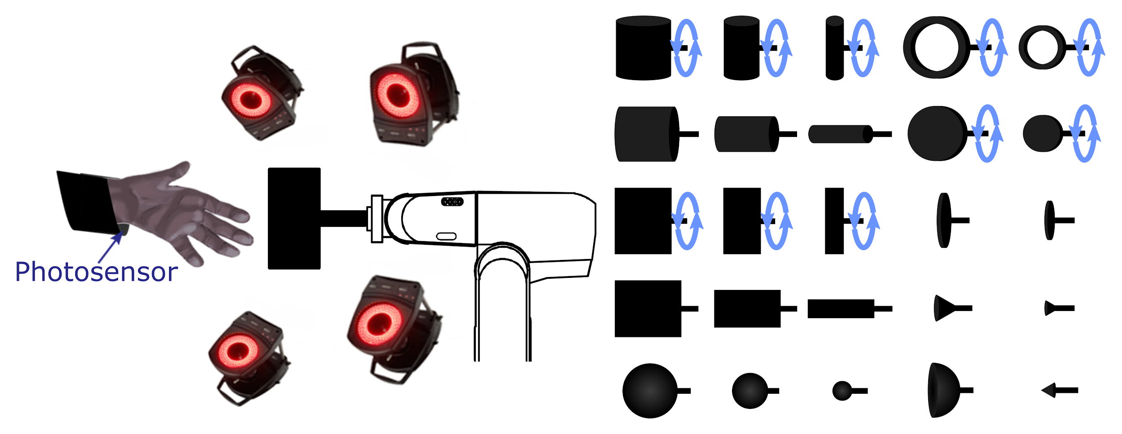
Grasp experiment
Notes:
Supplemental methods. Skipped

Slide 43
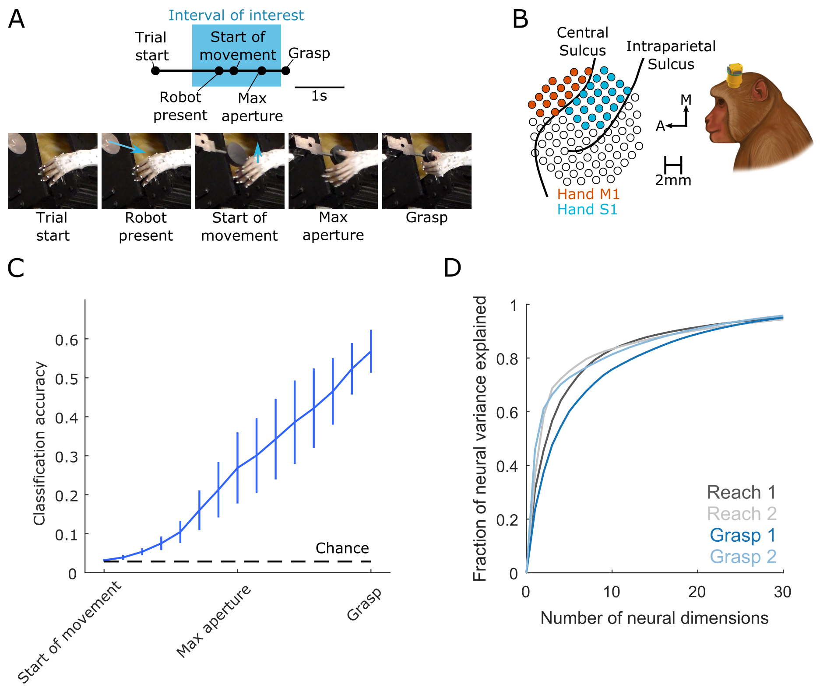
More grasp details
Notes:
Figure S1 of the paper. Skipped

Slide 44
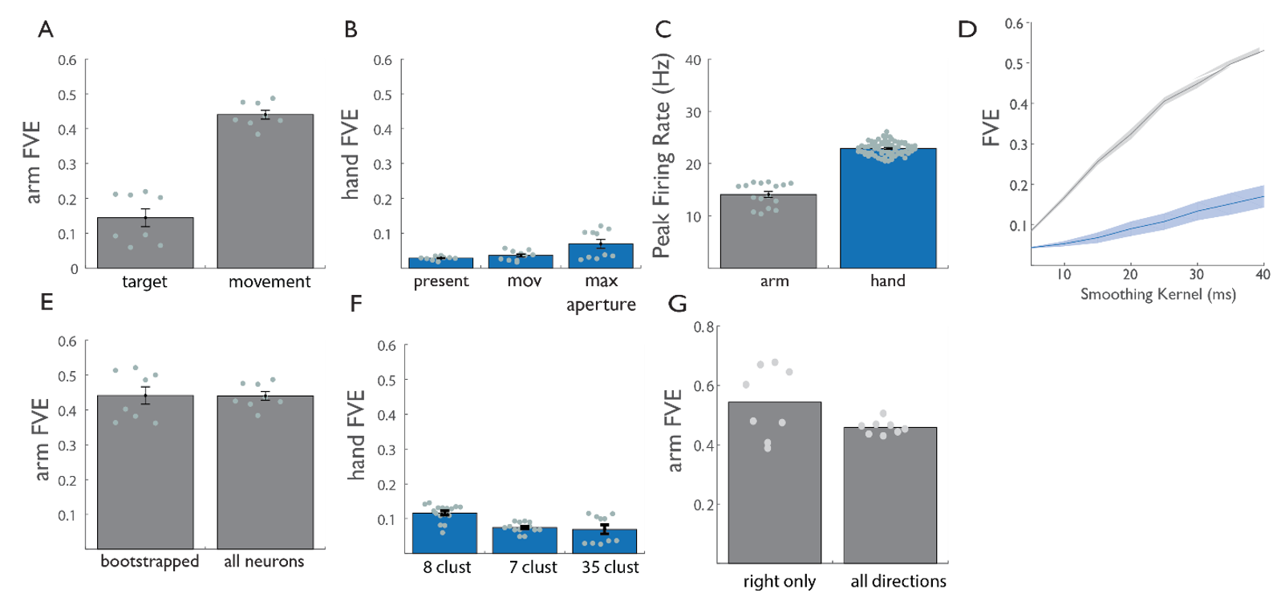
Control analyses
Notes:
Figure S2 of the paper. Skipped

Slide 45
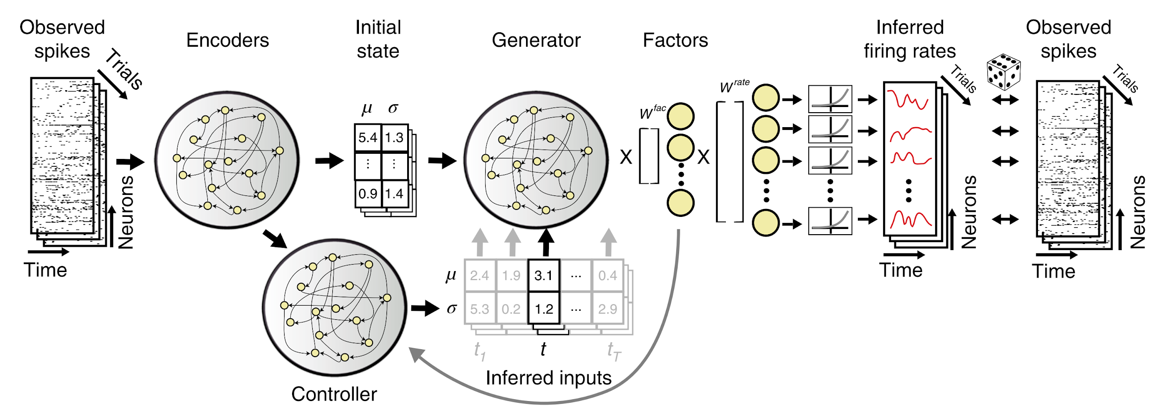
Second analysis: LFADS
Pandarinath, et al. 2018 Nature Methods
Notes:
LFADS assumes dynamical structure governs population firing rates
And not just linear dynamics: ANY dynamics
UGH that top figure is just confusing. Skipped.

Slide 46
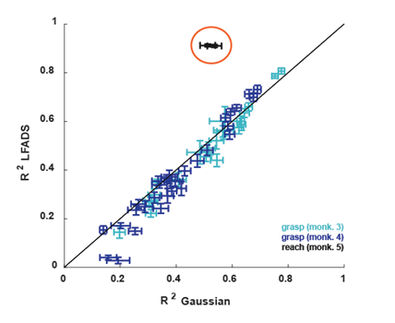
Decoder performance across joints
Notes:
This figure needs to be higher-res
Figure S3. Skipped

Slide 47
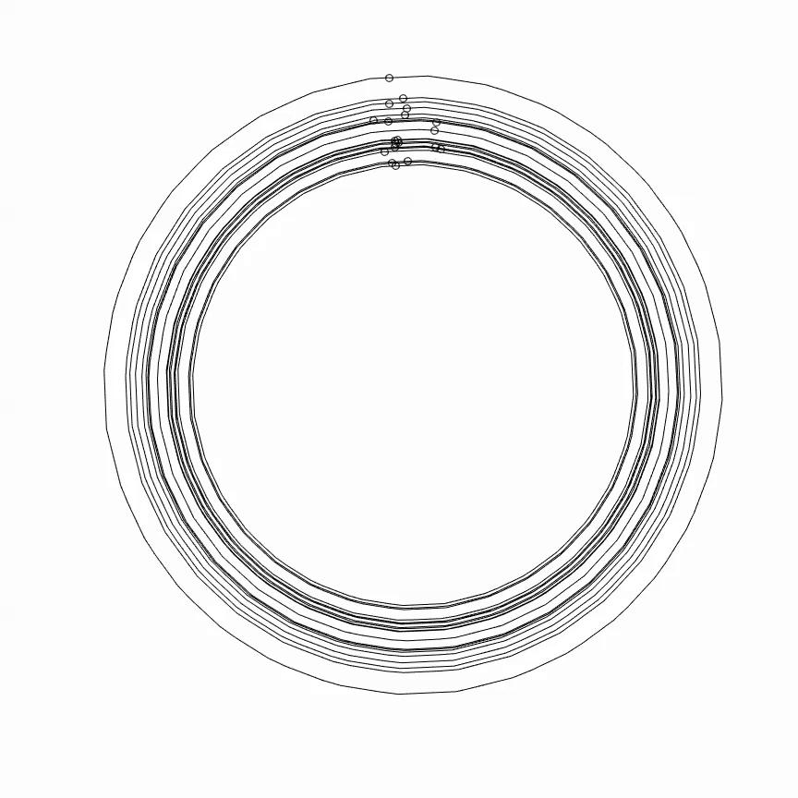
Model-free assessment: “Tangling”
Russo, et al. 2018 Neuron
Notes:
This is a nice, generic diagnostic developed by other folks

Slide 48
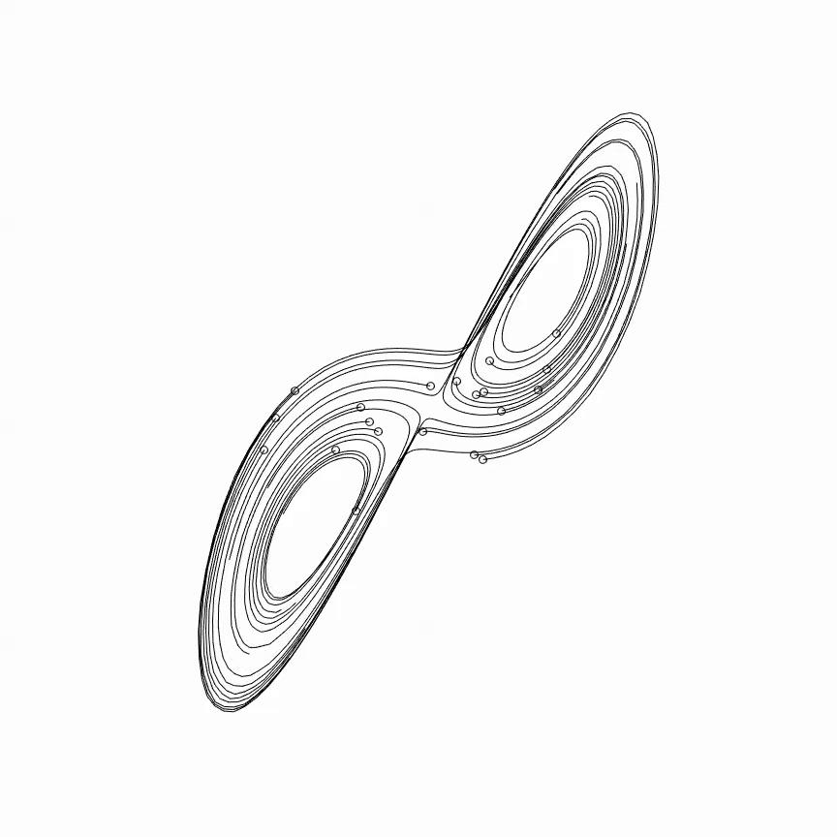
Model-free assessment: “Tangling”
Russo, et al. 2018 Neuron
Notes:
One last measure that we used to ascertain dynamical structure was one based on the concept of “tangling”. Thus far, we’ve been using methods that attempt to infer the form of the dynamics governing M1. But here, we use a metric based on “tangling” that measures the degree to which trajectories follow a consistent “flow field”: in other words, the trajectories of a dynamical system should not “cross over” themselves, but rather follow consistent “tracks”.

Slide 49
Illustrations of “smooth” and “nonsmooth” dynamics
Nonsmooth
Smooth

Slide 50
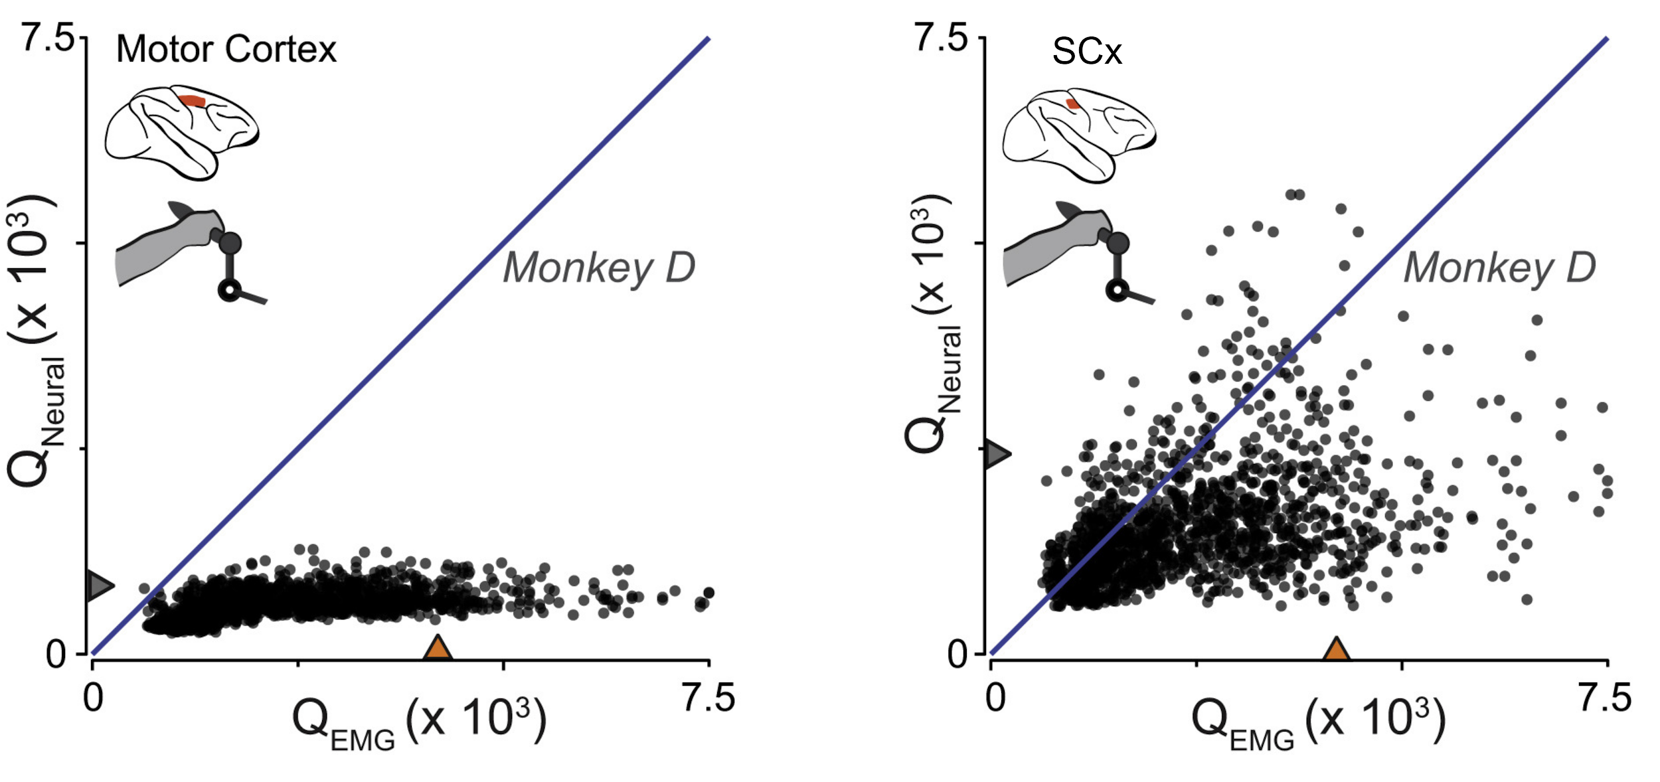
M1 less tangled than SCx during reach
Russo, et al. 2018 Neuron
Notes:
Previous research has established that, during reaching and cycling movements, SCx is indeed more tangled than is M1.

Slide 51
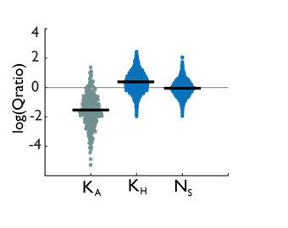
Quantifying relative tangled-ness
Notes:
This fig needs to be higher-res
And probably needs to be clarified with picture (as opposed to letter) labels
This figure needs to be edited to be interpretable, and even then we already quantified this shit with the unity-line plots. Skipped.

Slide 52
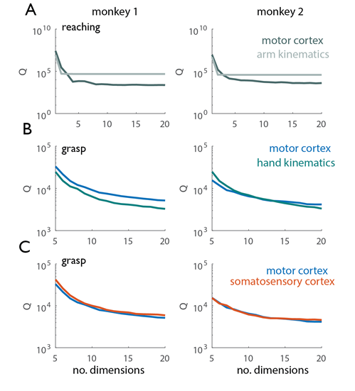
Tangling control analysis
Notes:
This also needs to be higher-res
Figure S4. Skipped.

Slide 53
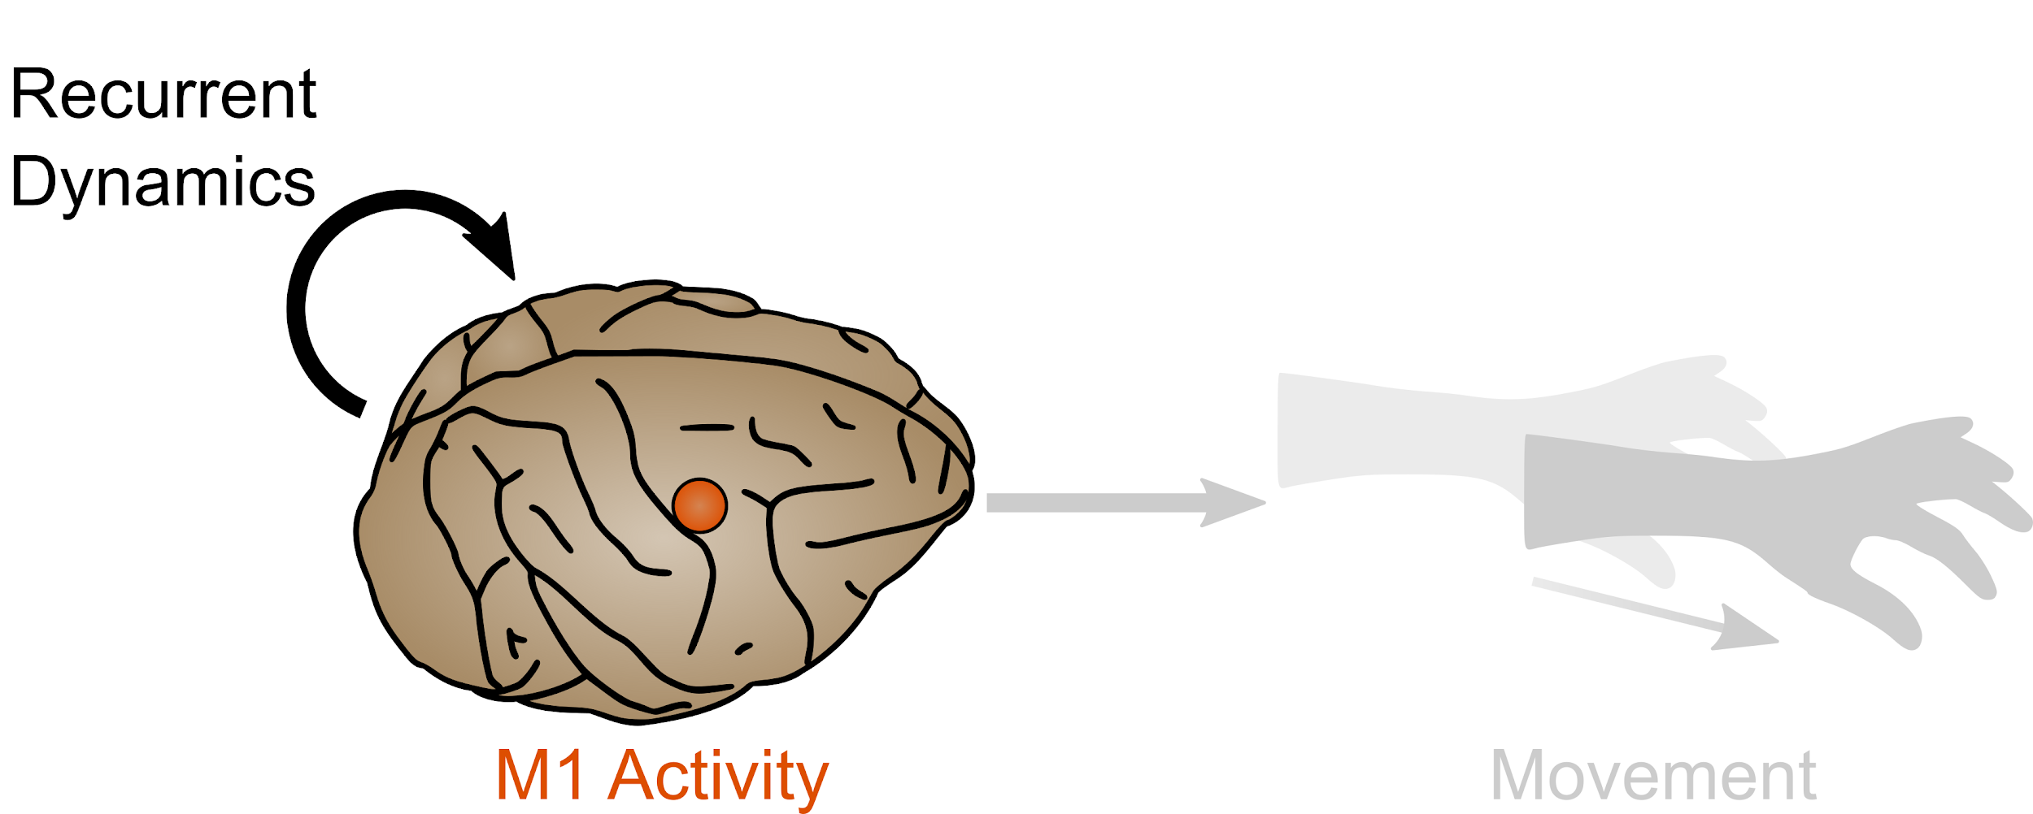
Inputs to a dynamical system
Notes:
So what could be going on to give rise to this? One hypothesis is that, during grasp, sources of input are more active or M1 is more susceptible to them than during reach. One such source of input, the one we typically study in the lab and the one from which we actually have recordings, is Somatosensory Cortex.

Slide 54
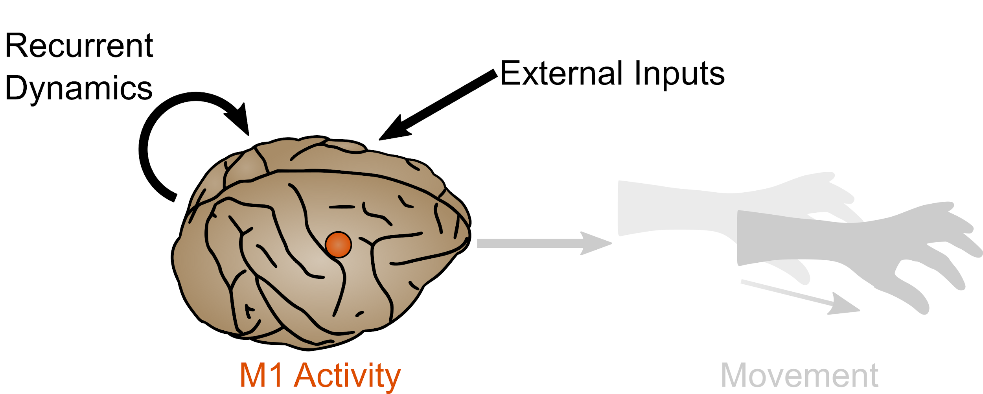
Inputs to a dynamical system
Notes:
So what could be going on to give rise to this? One hypothesis is that, during grasp, sources of input are more active or M1 is more susceptible to them than during reach. One such source of input, the one we typically study in the lab and the one from which we actually have recordings, is Somatosensory Cortex.

Slide 55
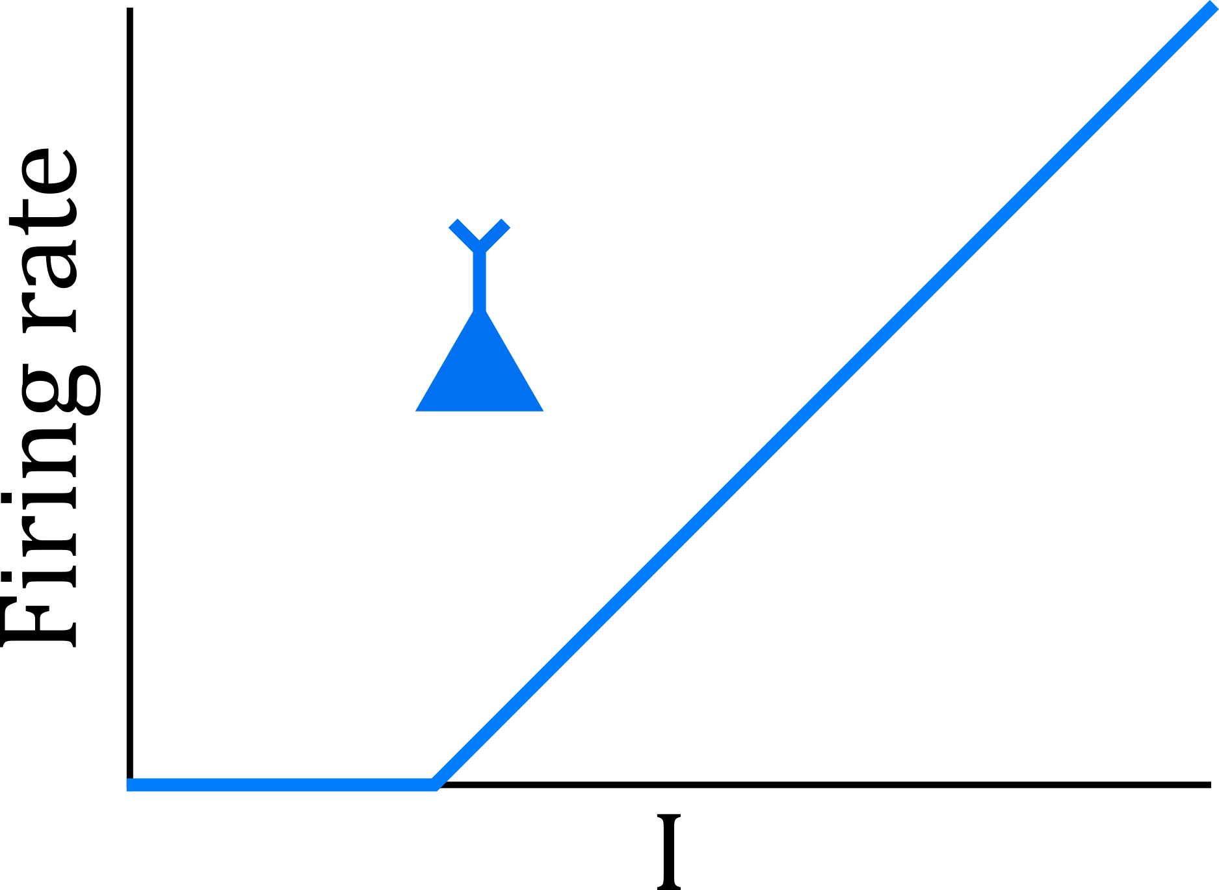
Why a non-smooth generator isn’t crazy
Notes:
This isn’t super outlandish - our models of the neurons themselves aren’t super smooth dynamical systems
This does come with advantages - more flexibility - albeit at the cost of noise-robustness

